Slide 1
Low Dropout Regulator
Made By
Basant Moheb El-malky

Slide 2
Architecture of SAR ADC with Low Dropout Regulator
Battery
BGR
LDO
V
IN
Sample-And-Hold
synchronous SAR Logic
D
OUT
Comparator
N-bit
DAC

Slide 3
LDO Principle
V
DROPOUT
V
Pass Device
V
IN
OUT
I
I
IN
OUT
+
IN
LDO
OUT
+
Reference
Error Amplifier
Loading
Circuit
V
GND
V
Loading
Circuit
IN
OUT
–
–
Voltage Divider

Slide 4
Architecture of Low Dropout Regulator
V = 1.2 V
DD
V
GS
V
V
DS
G
V = 0.9 V
REG
I = 5 ~ 30 mA
I
L
V = 0.75 V
R
R = 1K
V
REF
1
FB
R = 5K
C = 200 pF
2
L
20 uA

Slide 5
LOW DROPOUT REGULATOR SPECs
The design specifications that need to be achieved are
Technology | 45nm
Supply Voltage | 1.2 V
Reference Voltage | 0.75 V
Regulated Voltage | 0.9 V
Load Current | 5 mA – 30 mA
Load Capacitor | 200 pF
DC Gain | >= 40dB
PSR | <-30 dB
Phase-Margin | > 60 degrees

Slide 6
5T- Operational Trans conductance Amplifier SPECs
The design specifications that need to be achieved are
Technology | 45nm
Supply Voltage | 1.2 V
Open loop DC voltage gain | >= 30dB
CMRR @ DC | >= 74dB
Phase margin | >= 70
Load Capacitor | 5pF
OTA current consumption | <= 20uA
CM input range – low | <= 0.6V
CM input range – high | >= 1V
GBW | >= 5MHz

Slide 7
OTA Design
Topology selection:
Since that gain isn’t very high (34dB) so we can use single stage OTA
The input range is (0.6v - 1v ) near VDD reals so it’s preferred to use NMOS as input pair
Load would be PMOS – the tail CS is to be NMOS

Slide 8
Sizing of 5T- Operational Trans conductance Amplifier using Virtuoso Tool

Slide 9
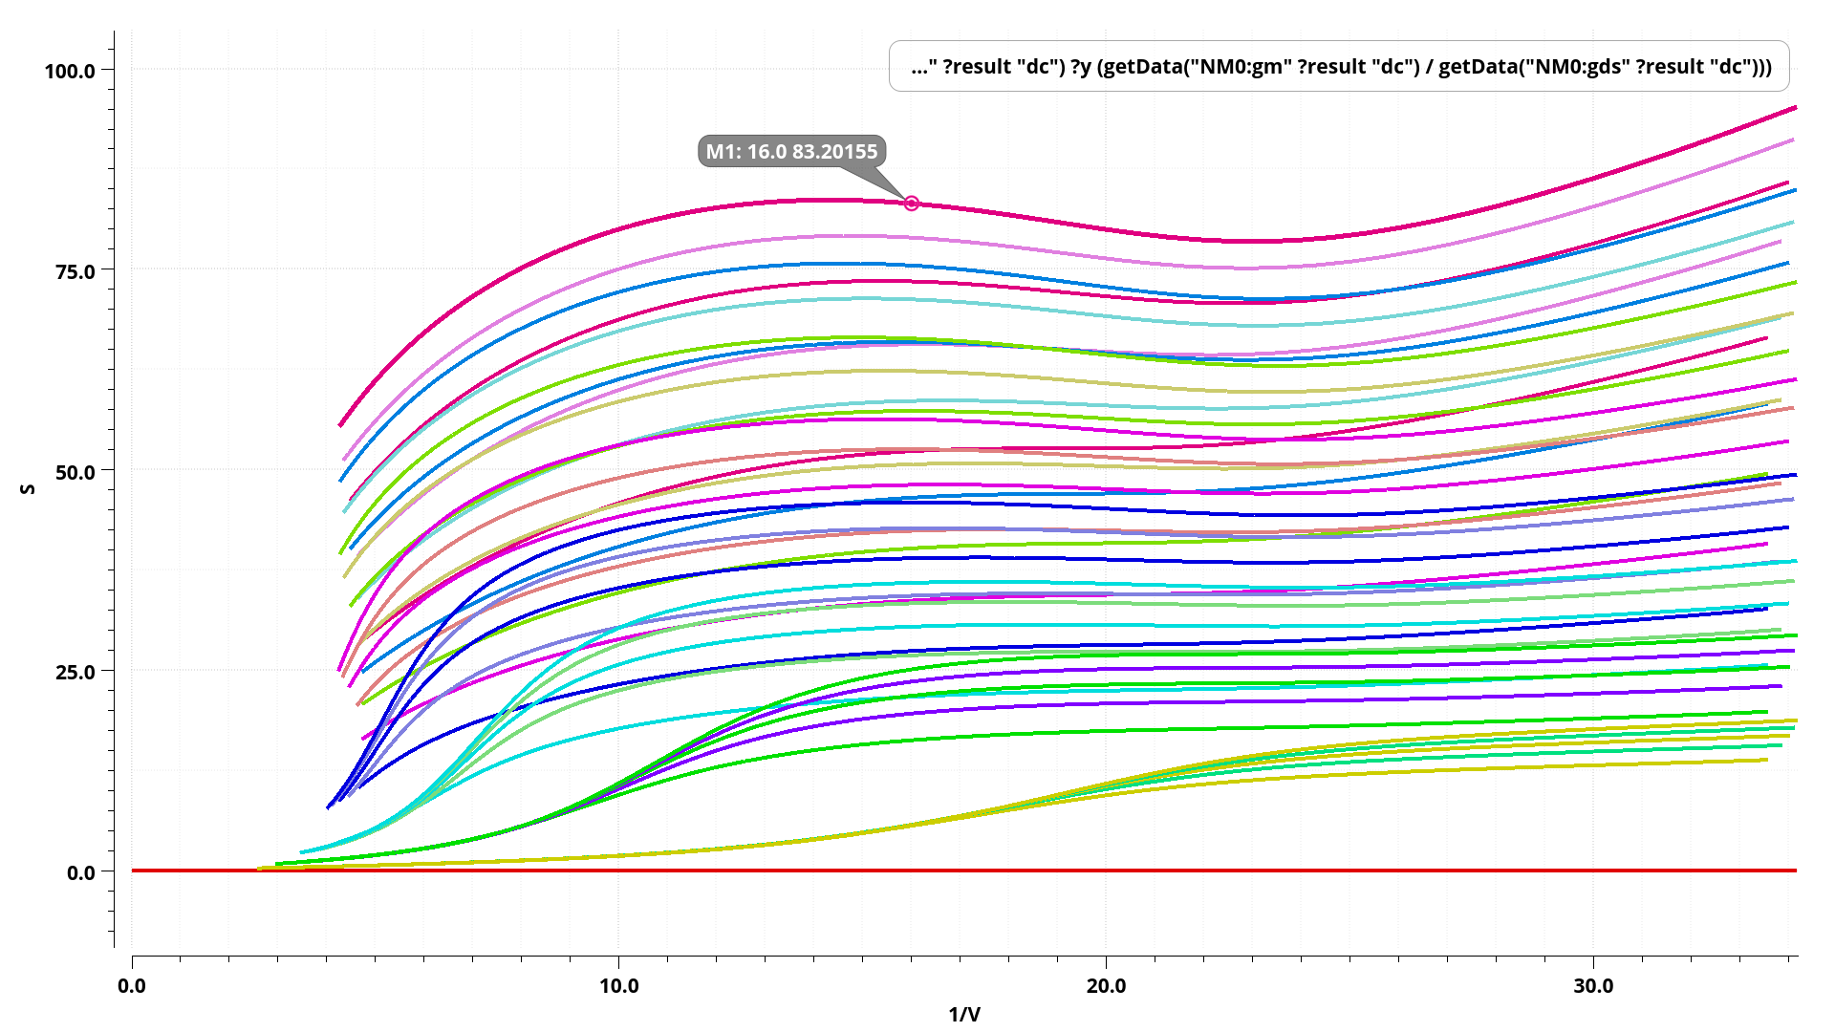
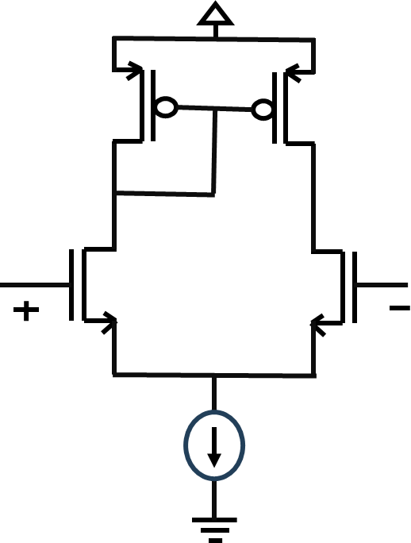
GM/GDS vs GM/ID for NMOS input pair

Slide 10
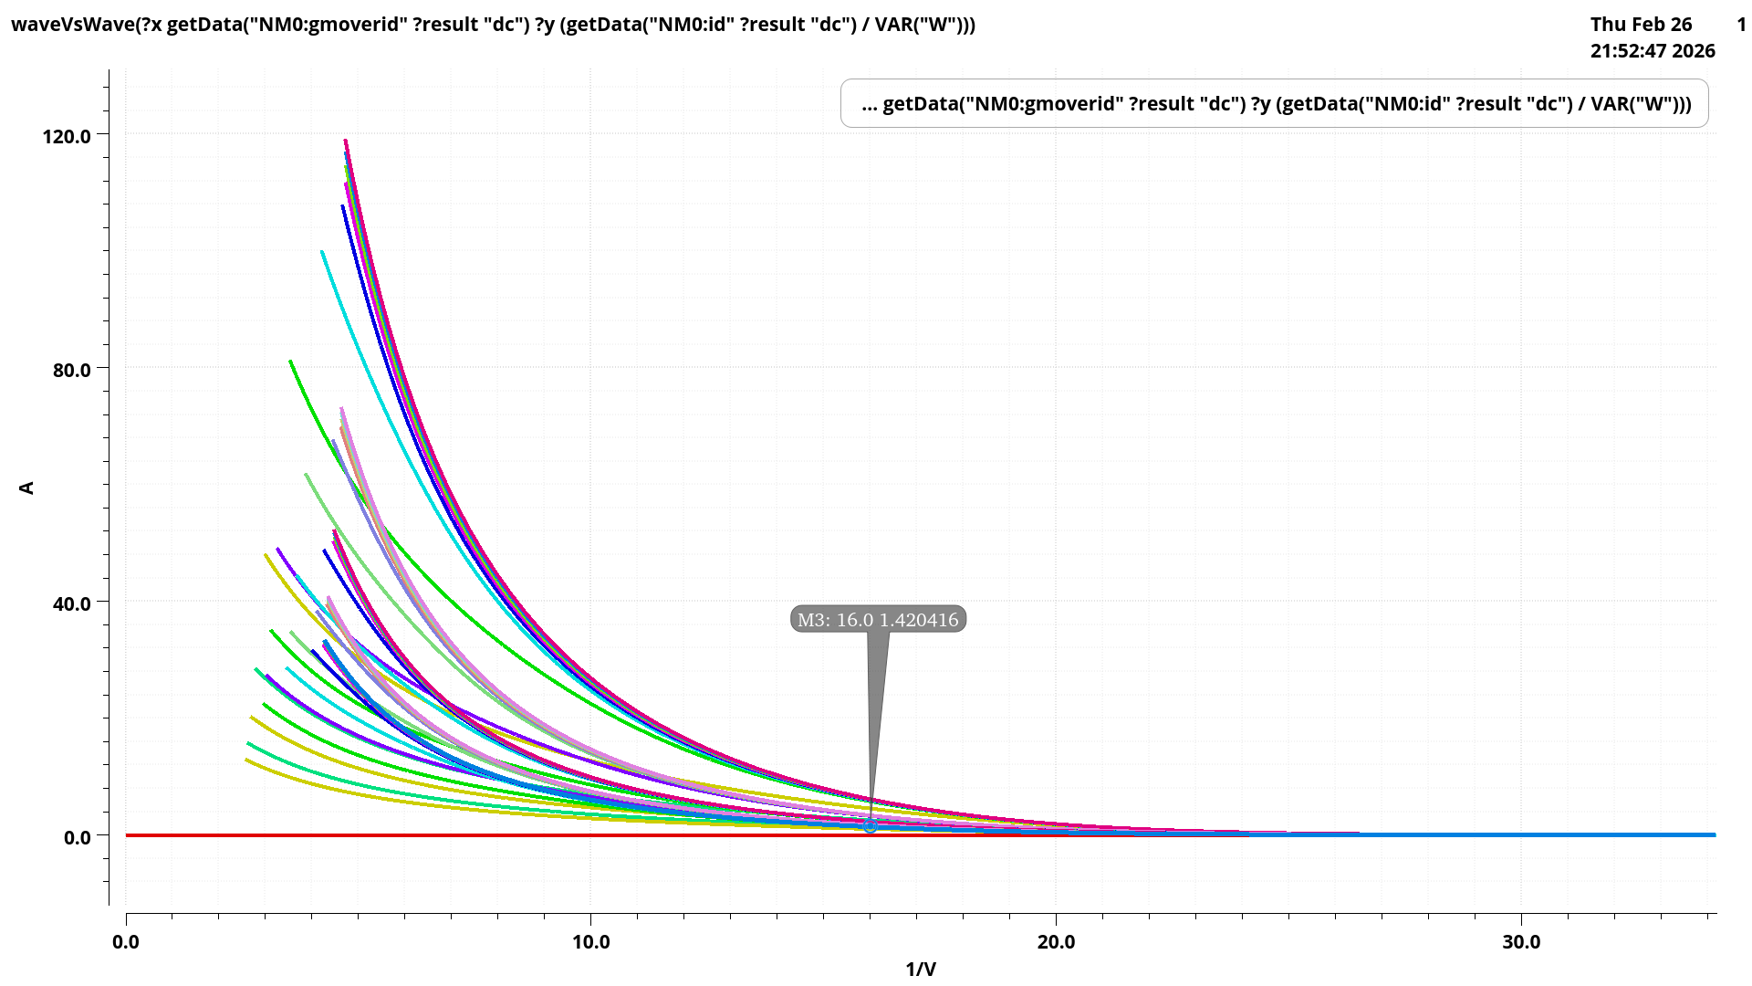
ID/W vs GM/ID for NMOS input pair

Slide 11
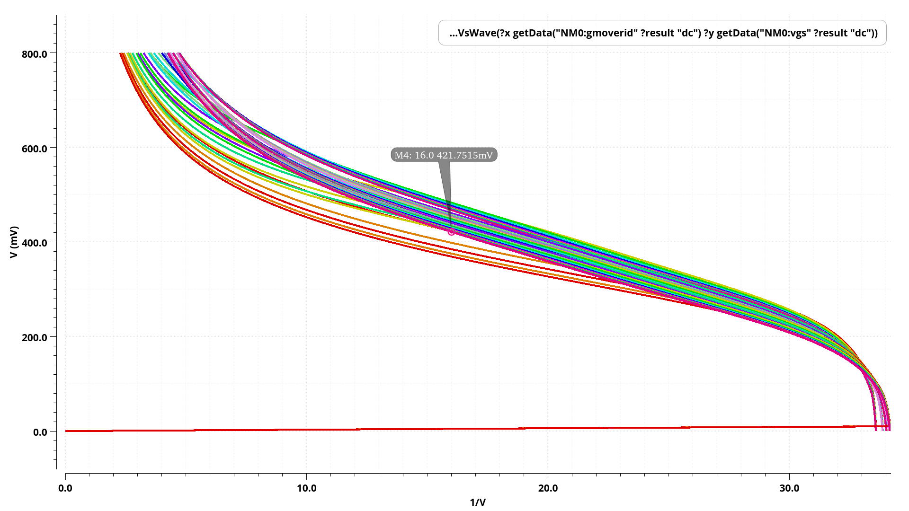
VGS vs GM/ID for NMOS input pair

Slide 12
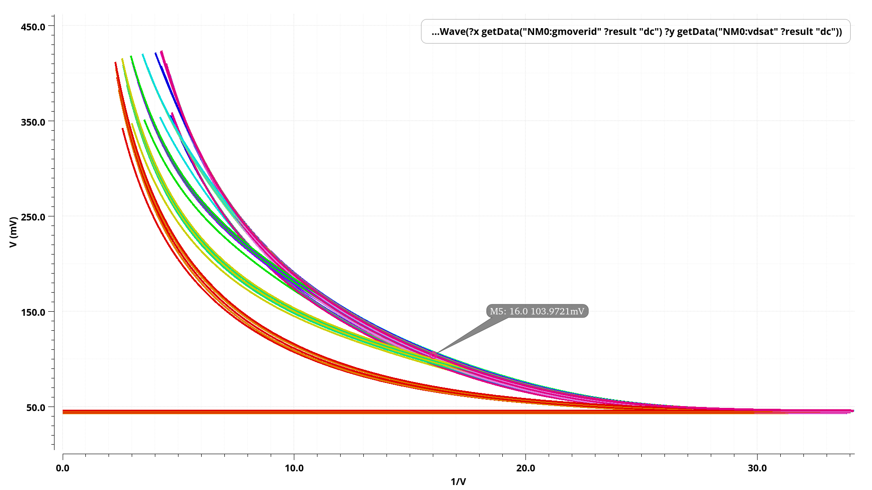
VDSAT vs GM/ID for NMOS input pair

Slide 13
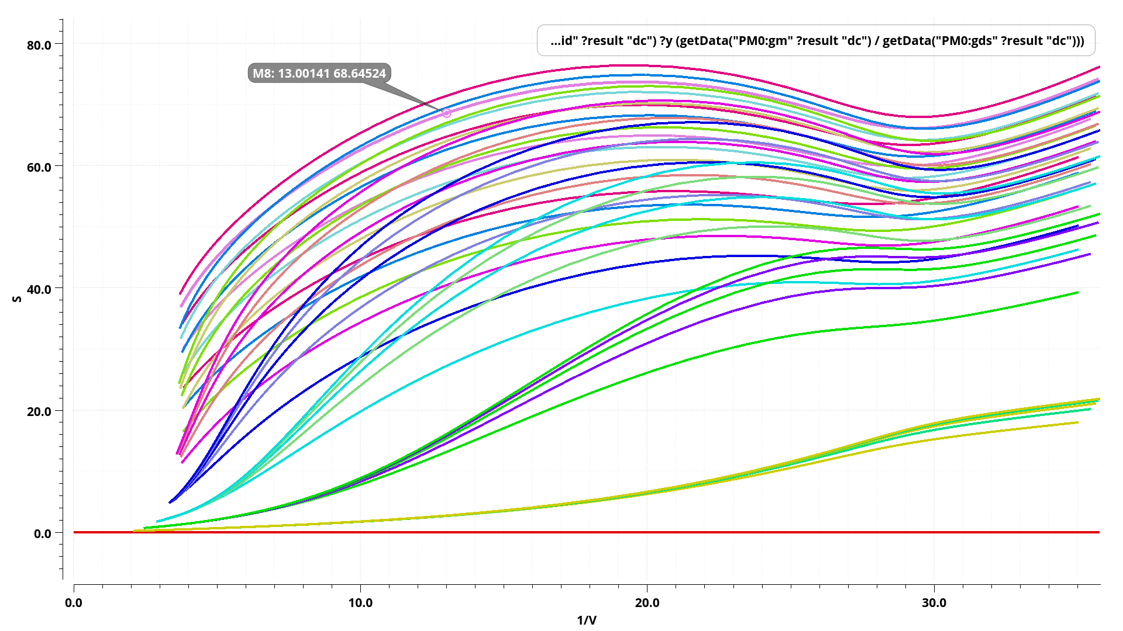
GM/GDS vs GM/ID for PMOS Load

Slide 14
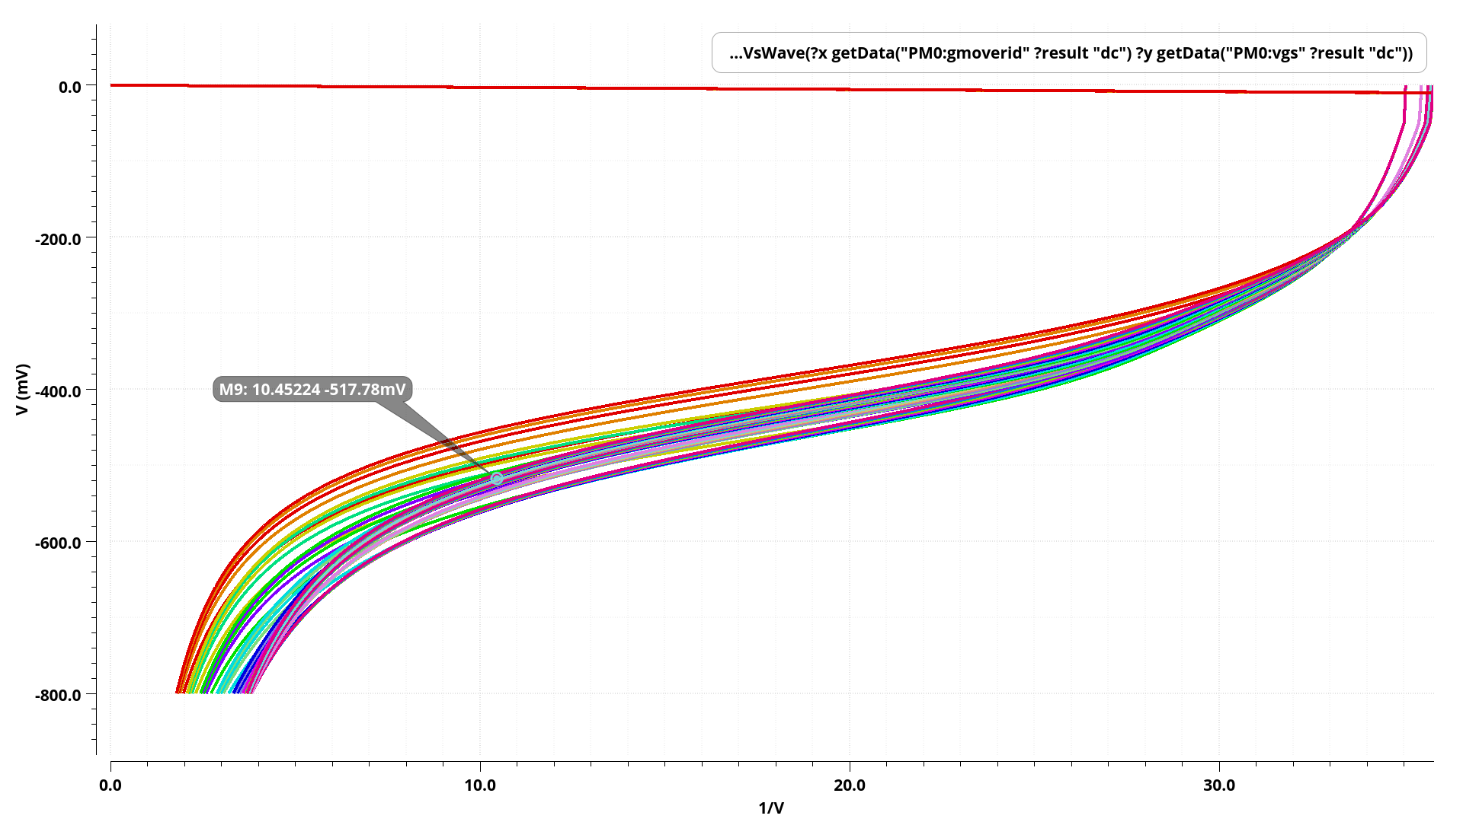
VGS vs GM/ID for PMOS Load

Slide 15
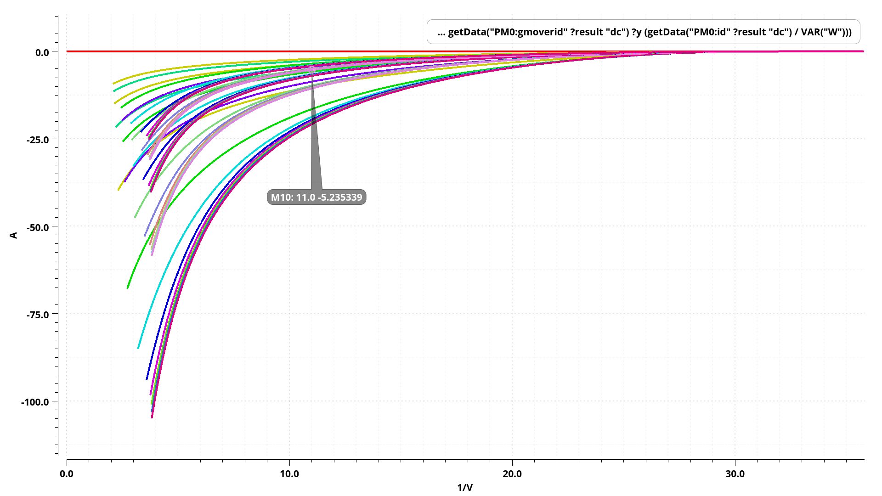
ID/W vs GM/ID for PMOS Load

Slide 16
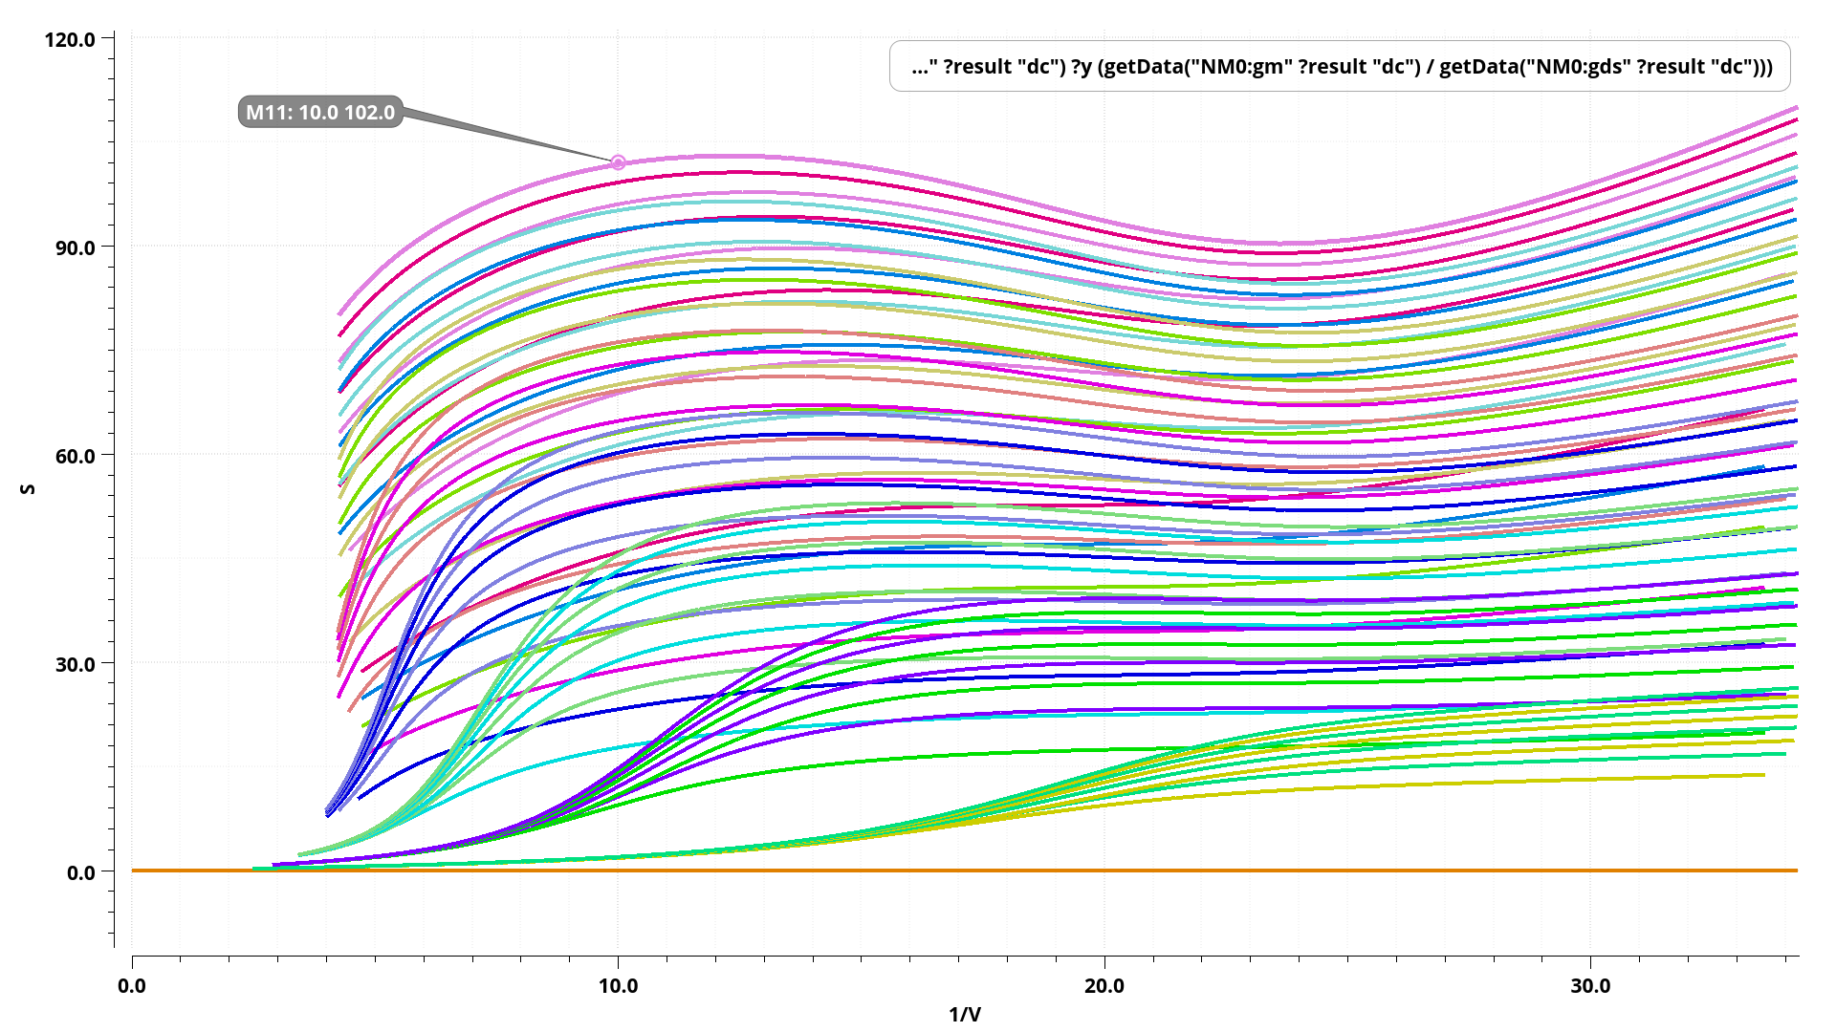
GM/GDS vs GM/ID for NMOS Tail Current Source

Slide 17
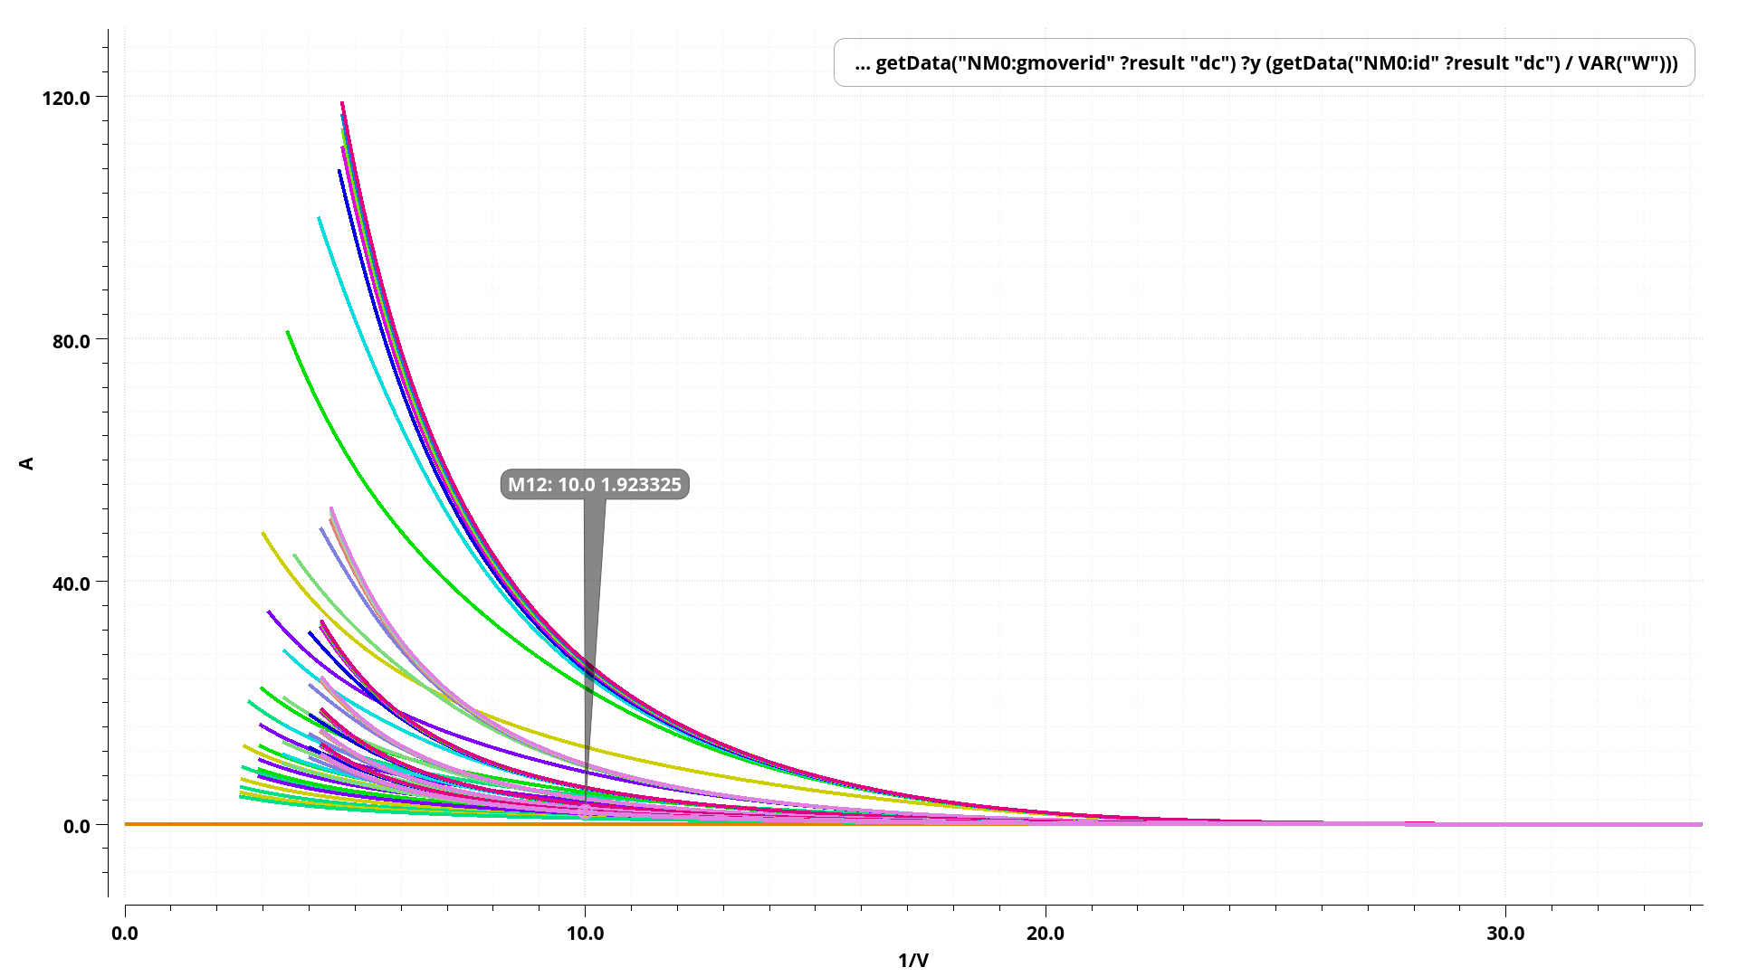
ID/W vs GM/ID for NMOS Tail Current Source

Slide 18
Sizing of 5T- Operational Trans conductance Amplifier using GDIE Tool

Slide 19
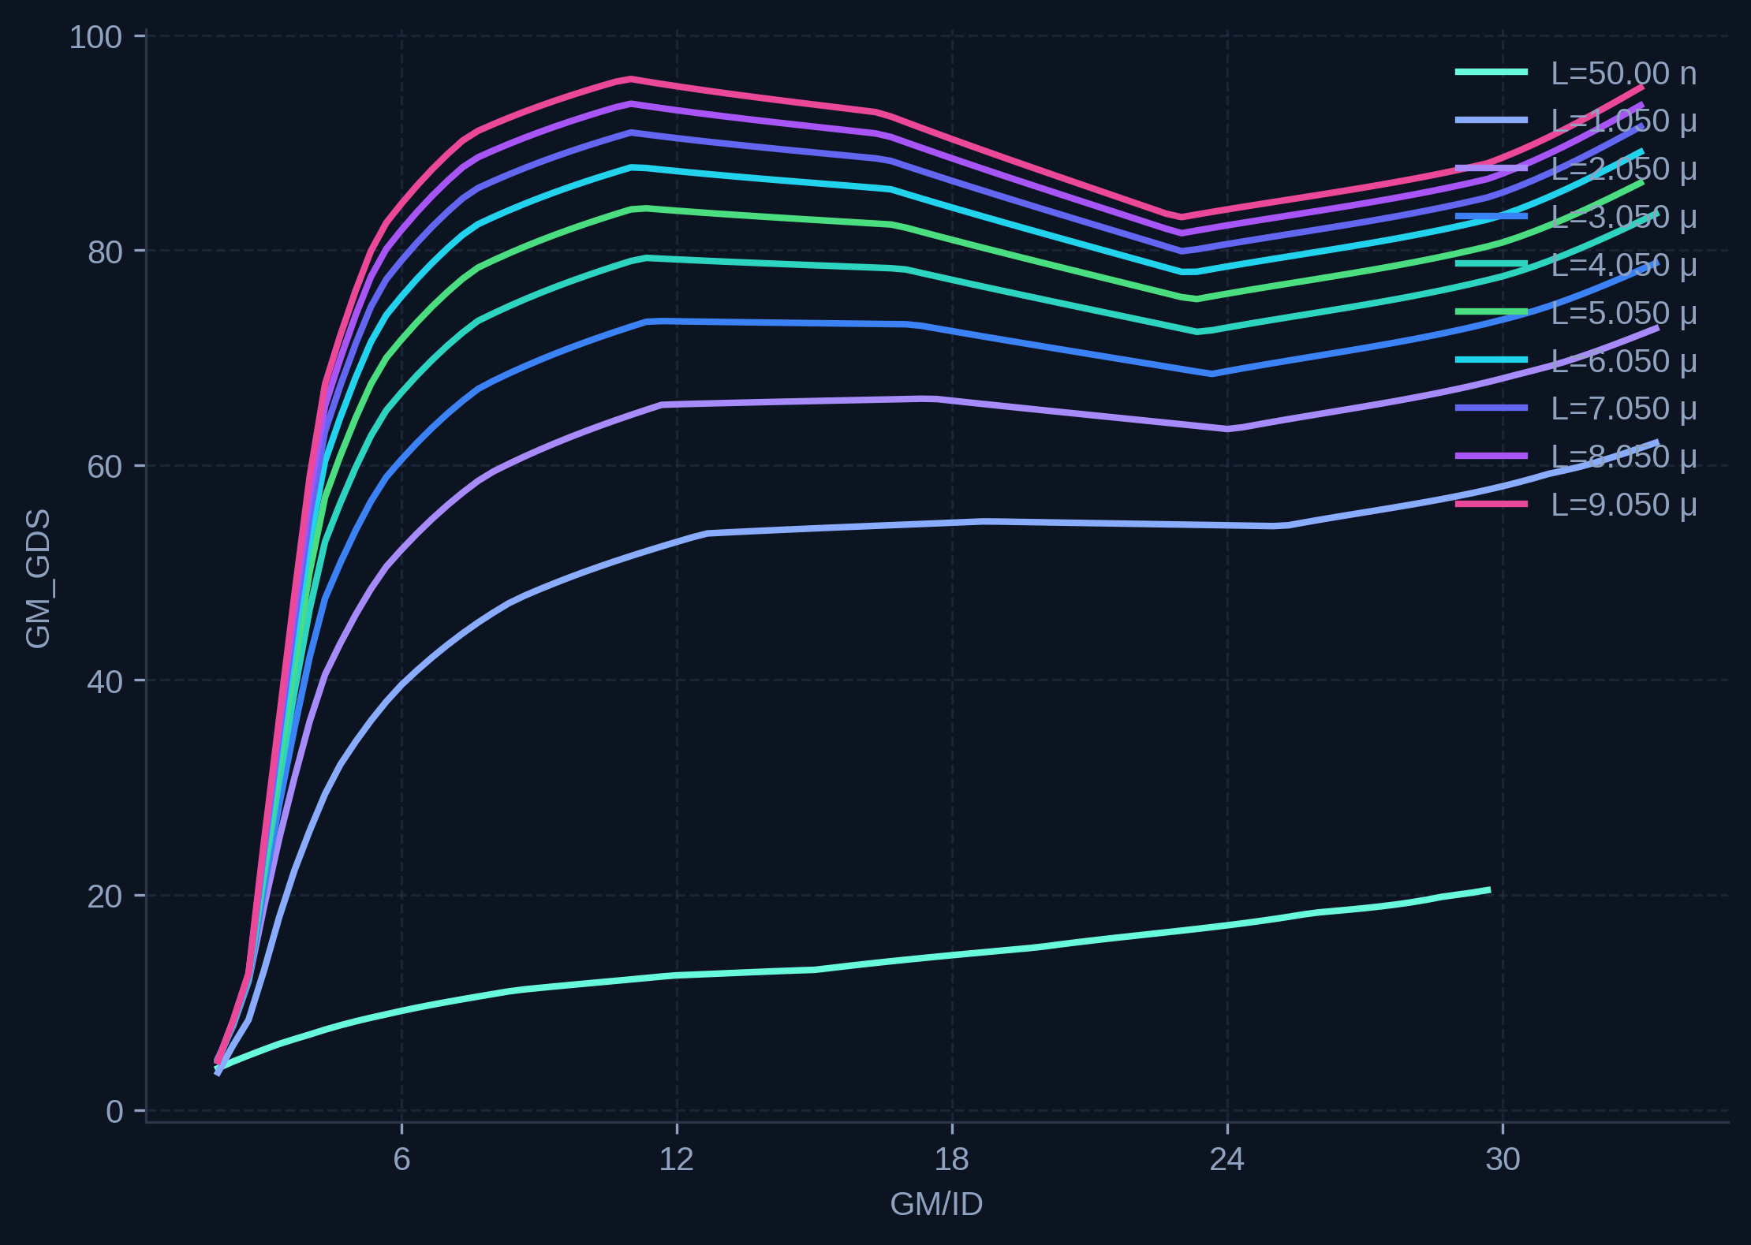

Slide 20
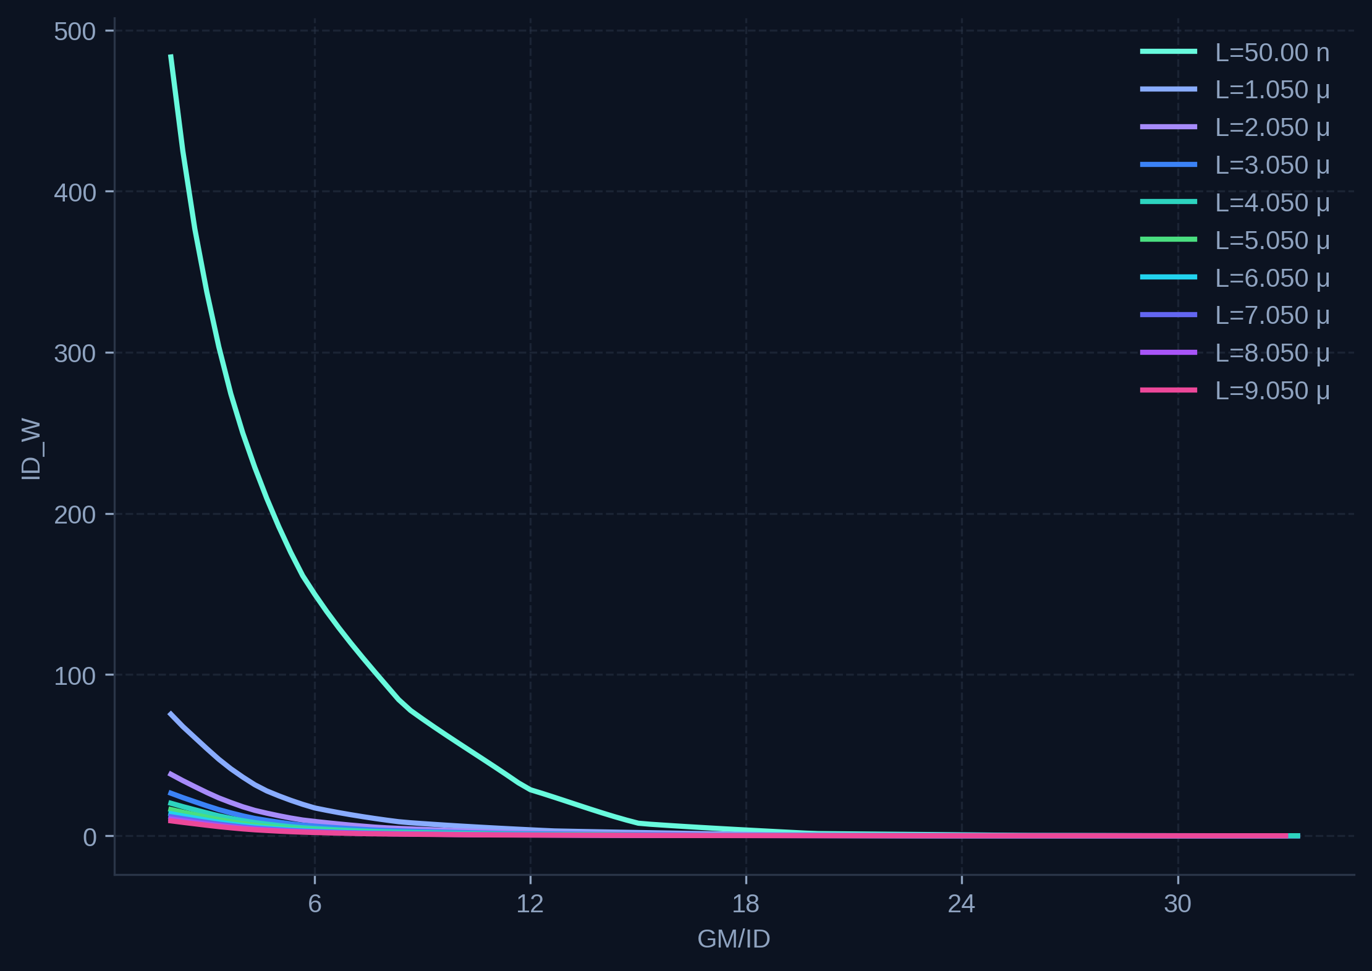

Slide 21
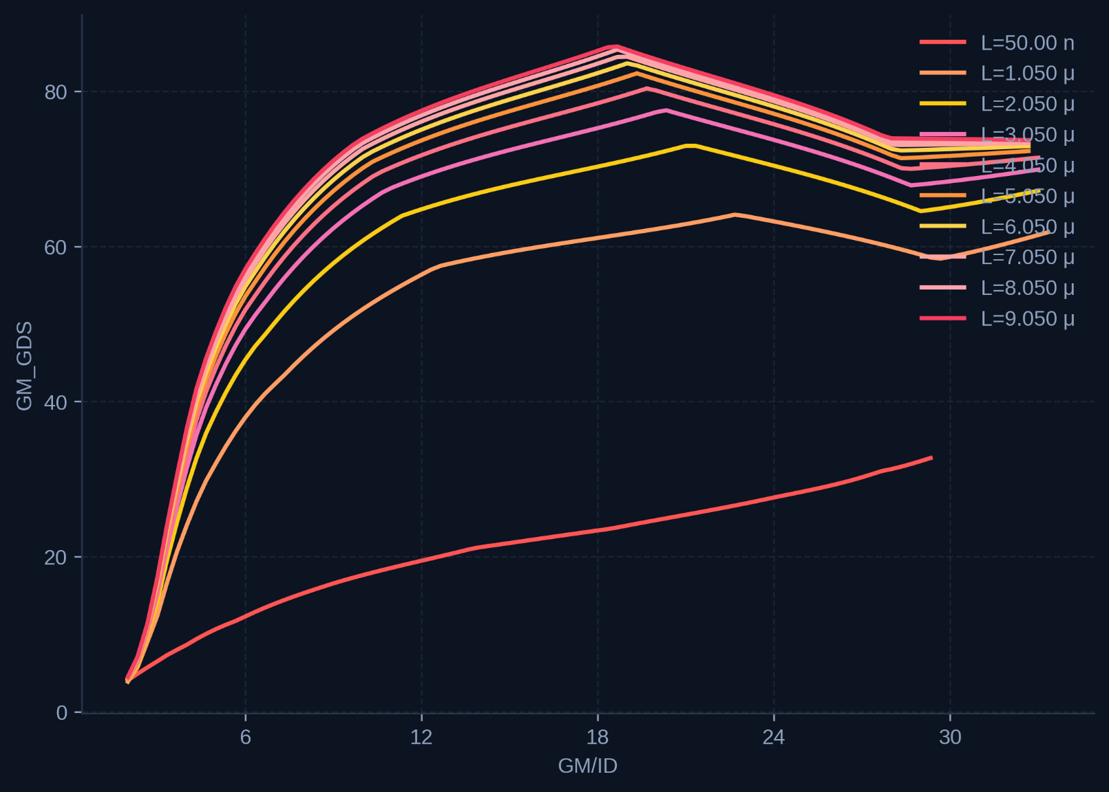

Slide 22
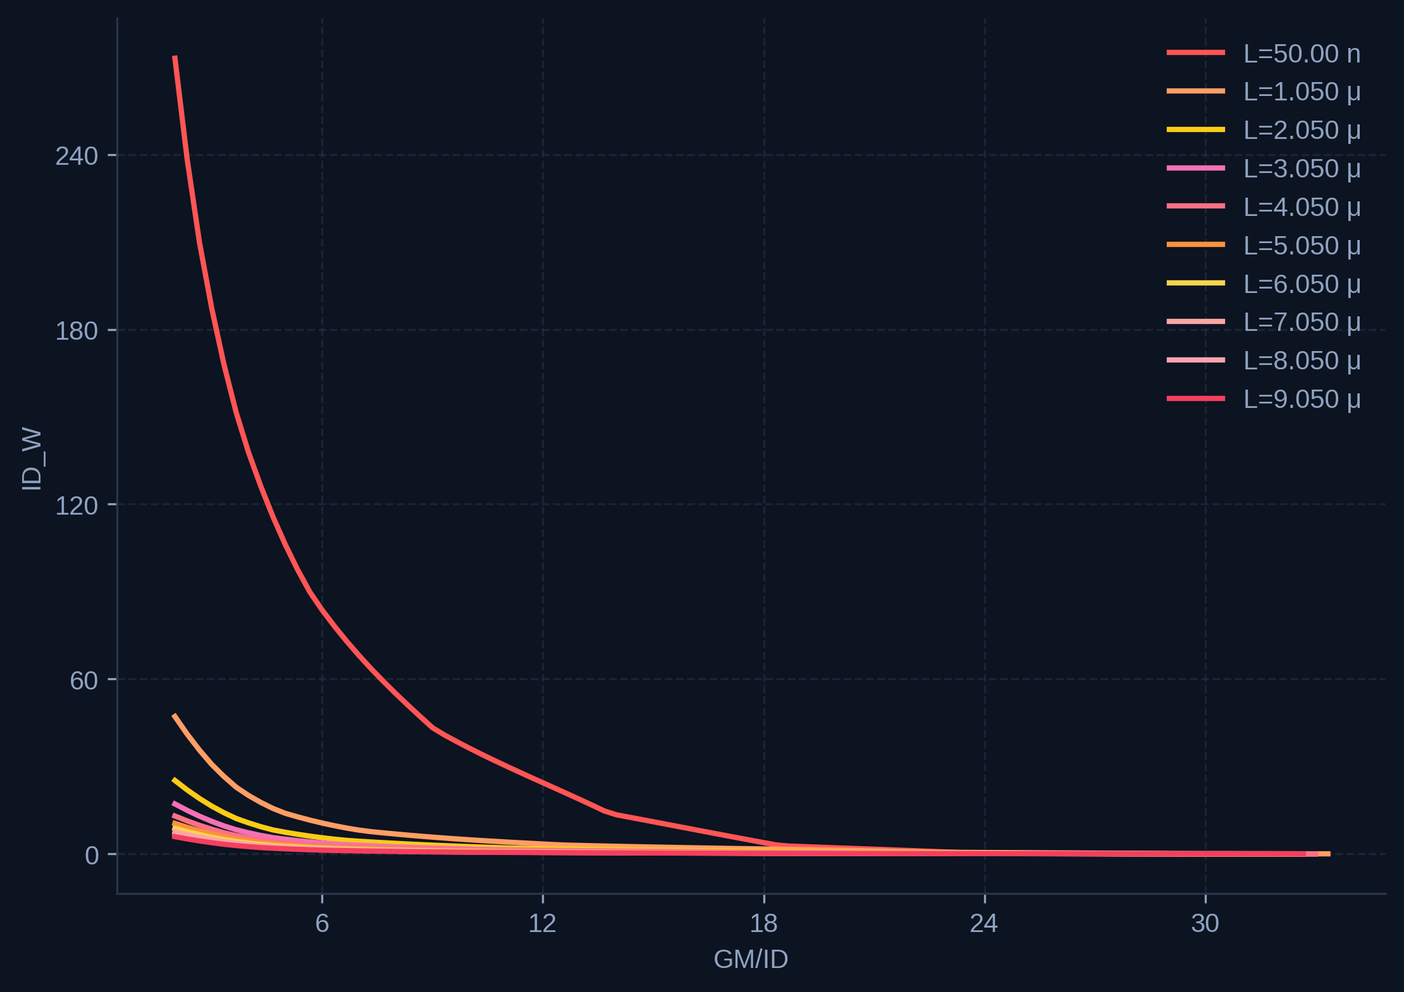

Slide 23
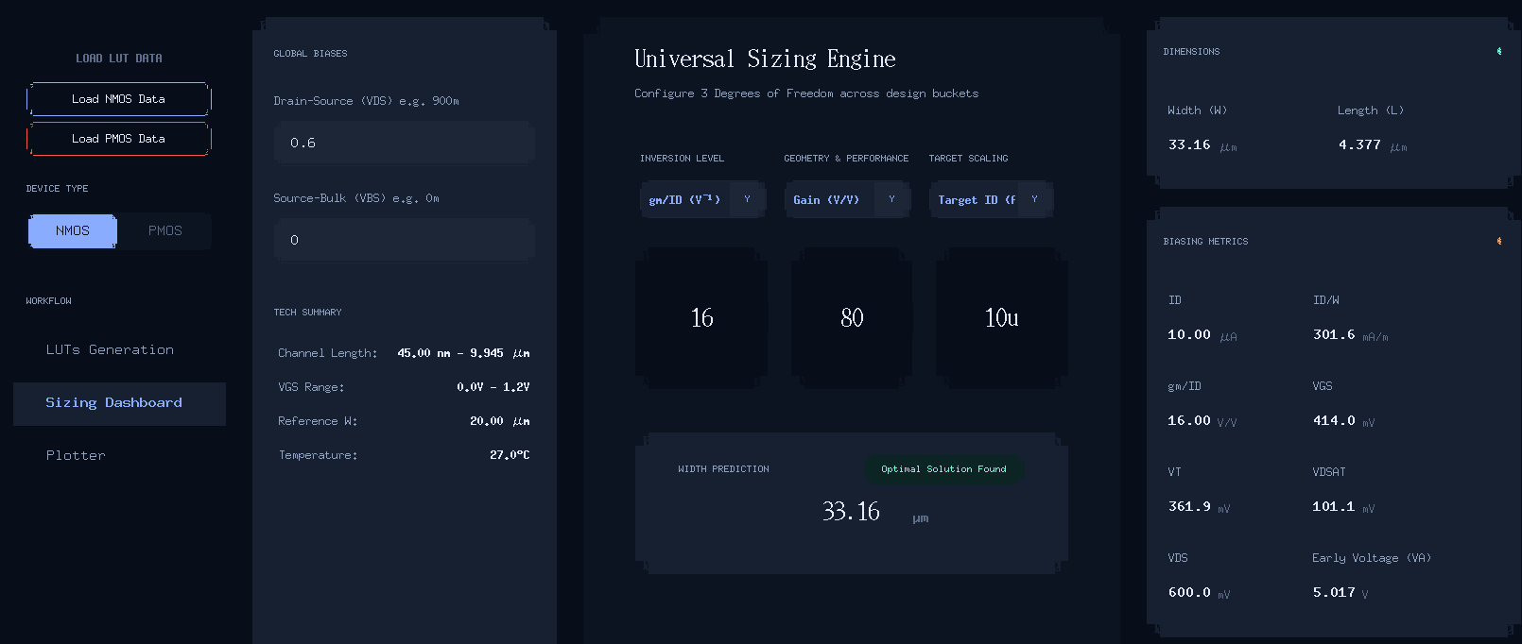
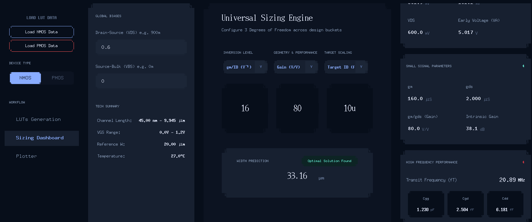

Slide 24
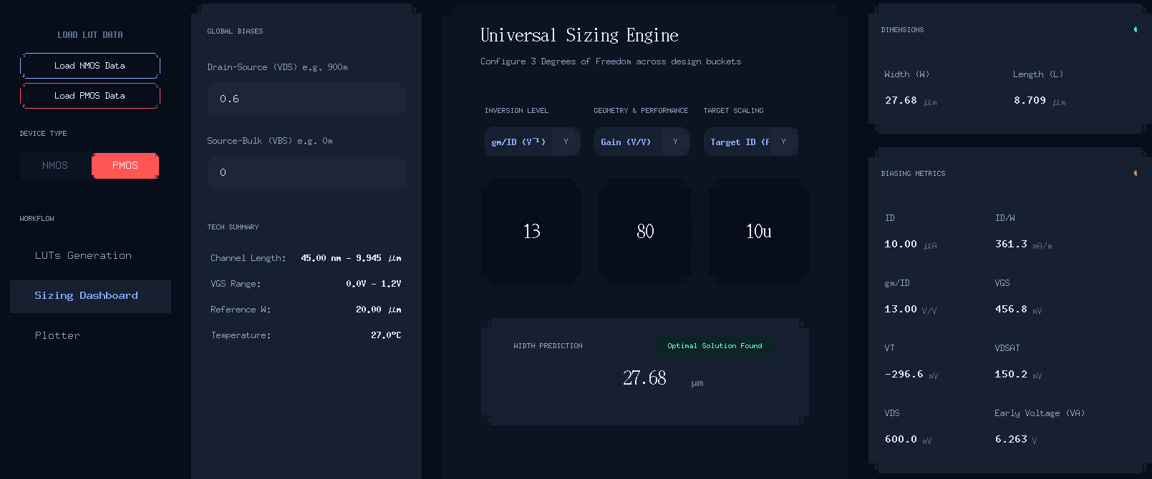

Slide 25


Slide 26
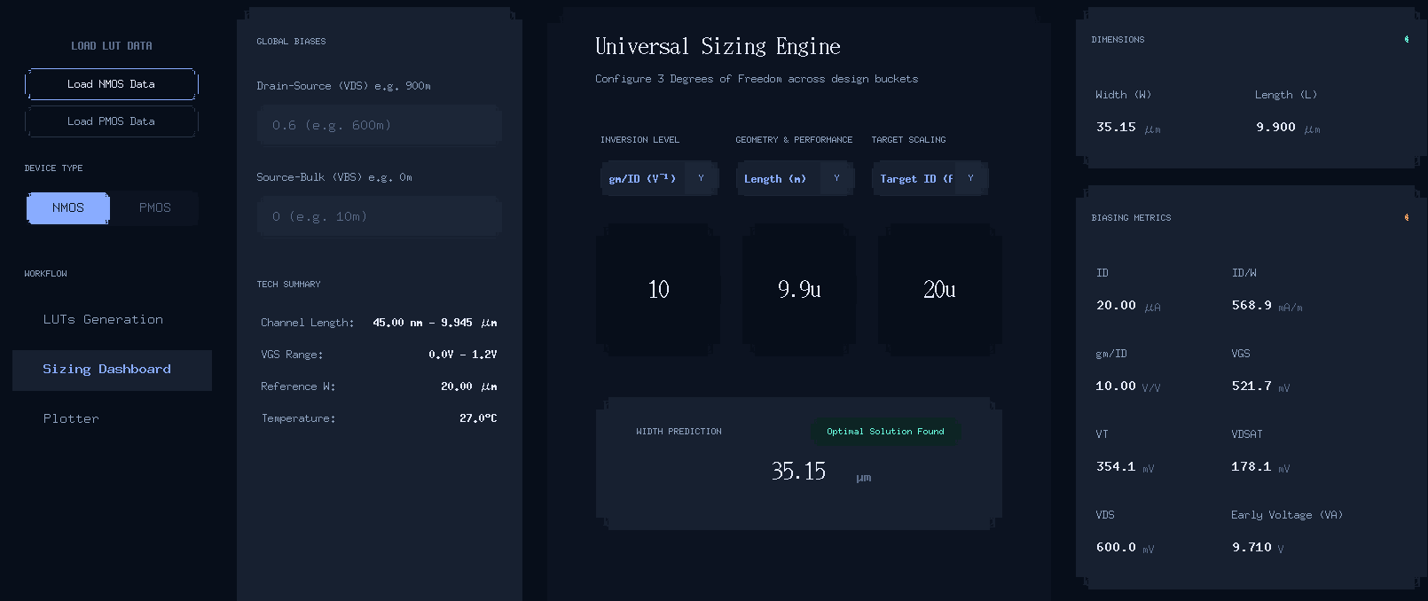
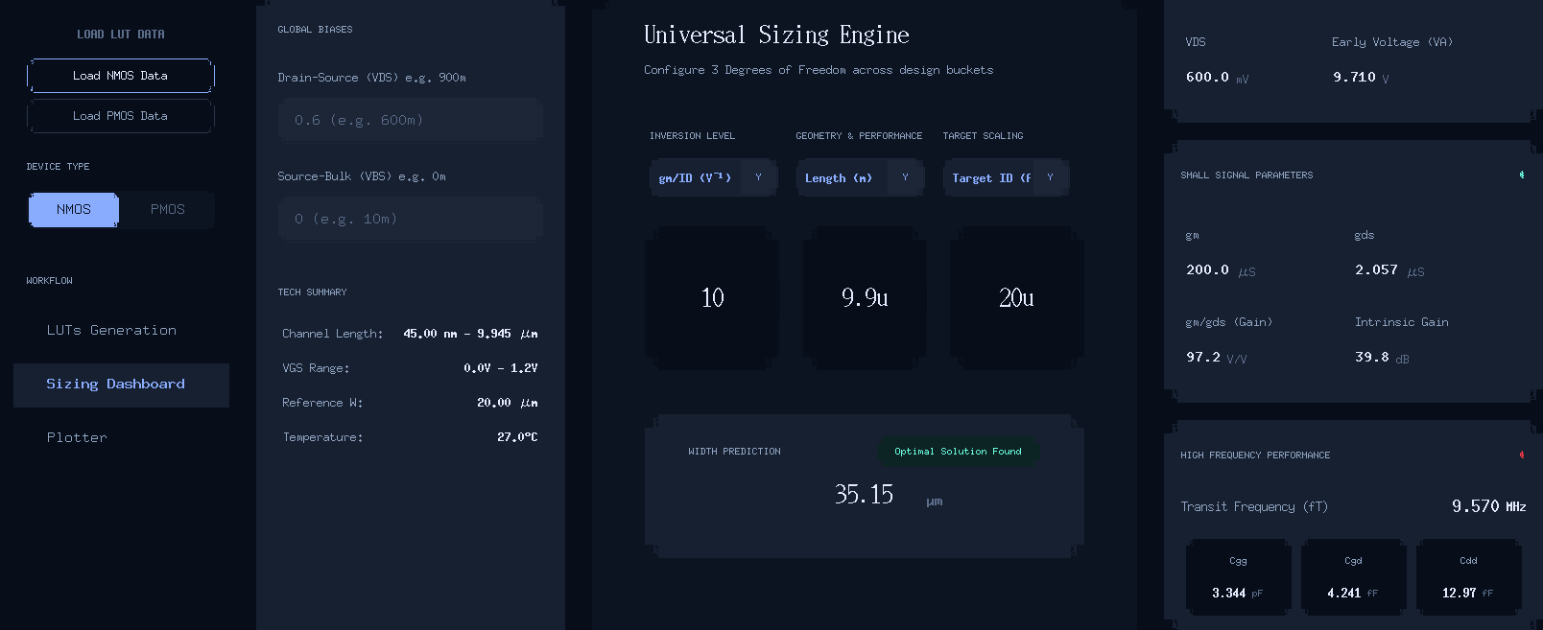

Slide 27
Sizing of PMOS Transistor using Virtuoso Tool

Slide 28
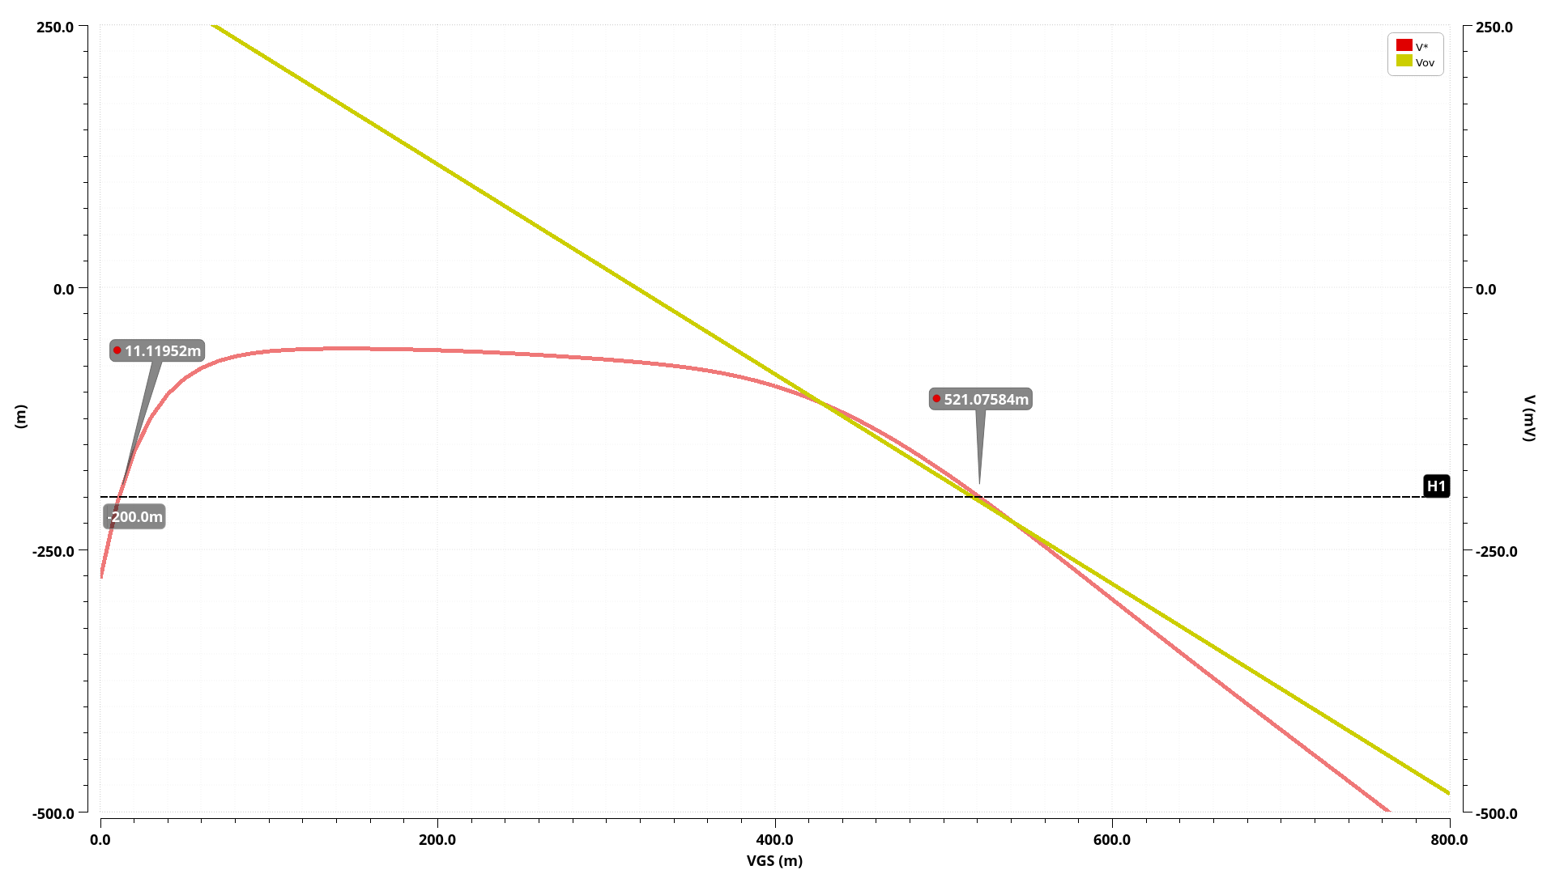
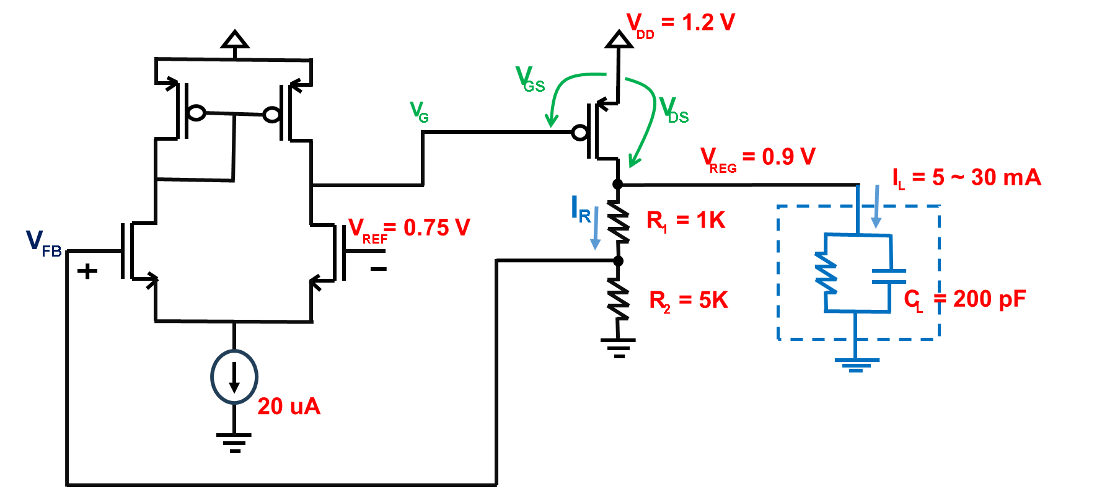
V* and Vov vs VGS for PMOS Pass Transistor

Slide 29
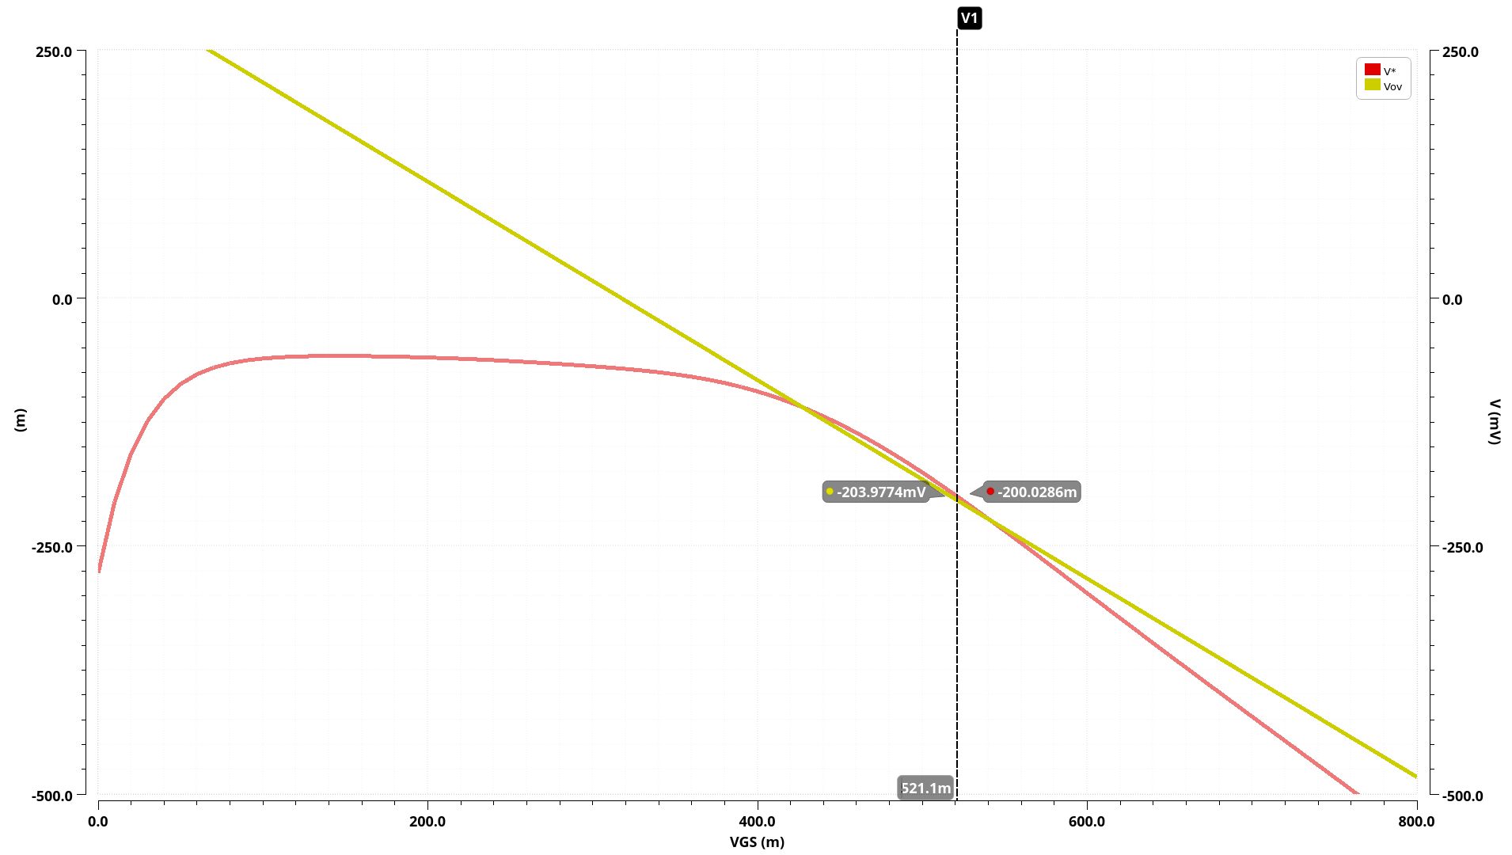
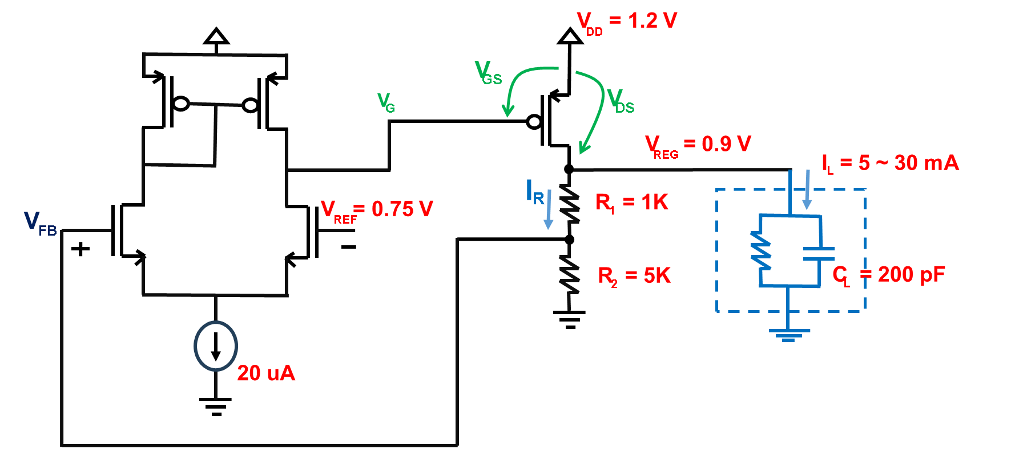
V* and Vov vs VGS for PMOS Pass Transistor

Slide 30
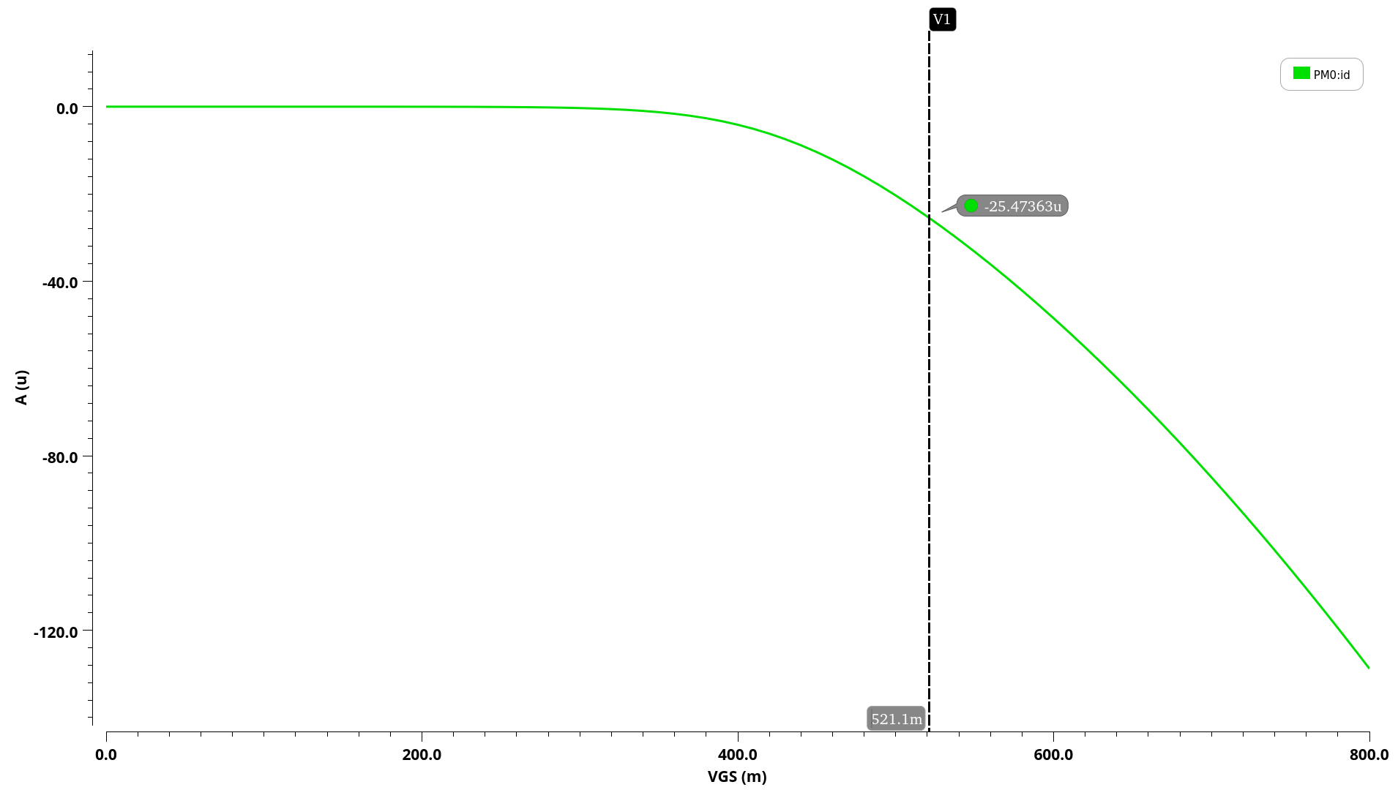
ID vs VGS for PMOS Pass Transistor

Slide 31
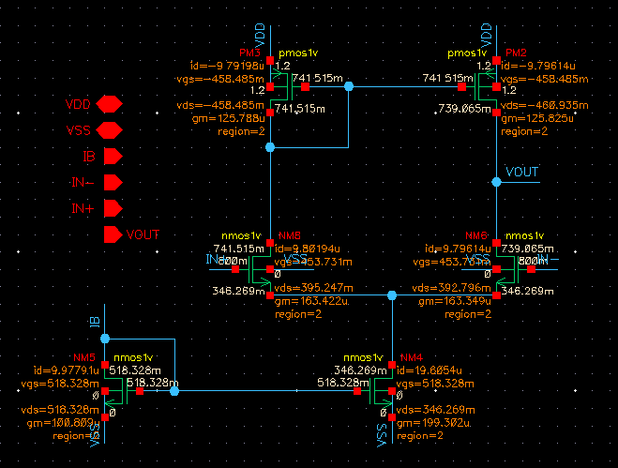
Operation Regions of the OP-AMP

Slide 32
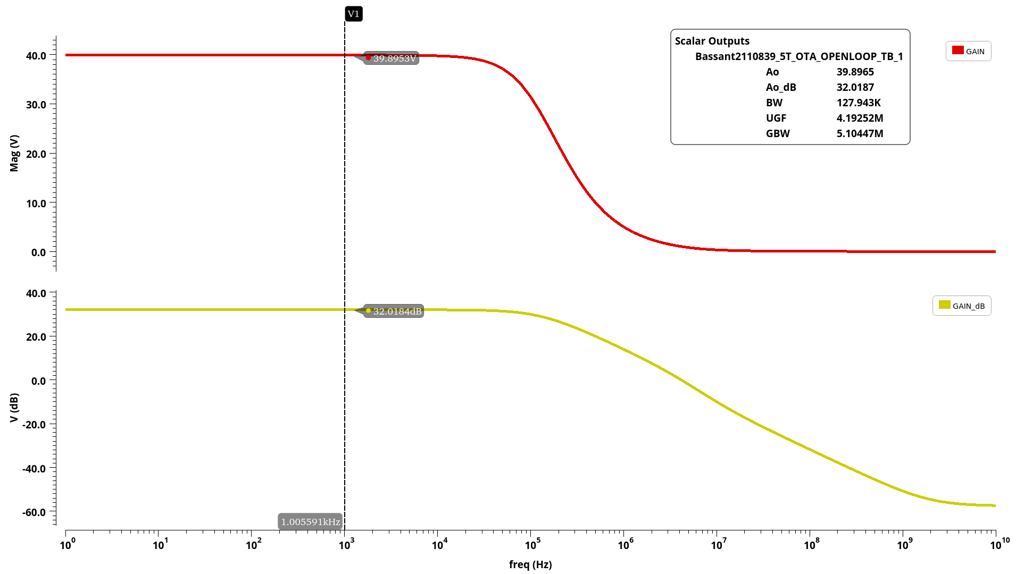
Open loop Gain for the OP-AMP
PARAMETER | SPEC | ACHIEVED
GAIN | >= 30dB | 32dB
GBW | >=5MHZ | 5MHZ

Slide 33
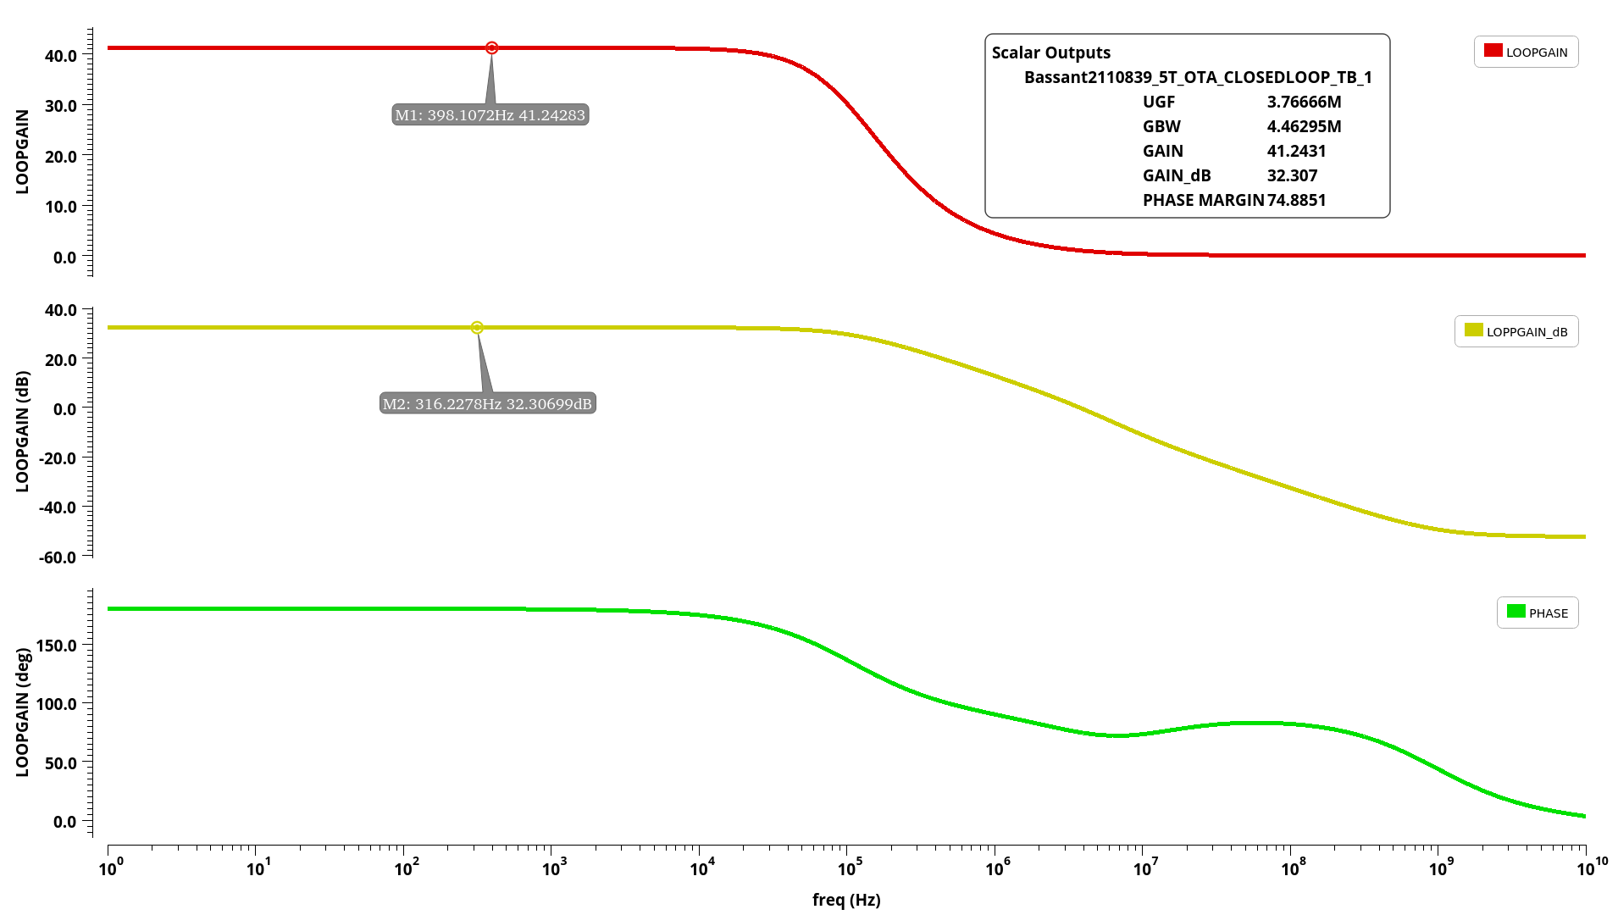
Closed loop Gain for the OP-AMP
PARAMETER | SPEC | ACHIEVED
GAIN | >=30dB | 32dB
PHASE MARGIN | >=70 | 74
GBW | >=5MHZ | 4.46MHZ

Slide 34
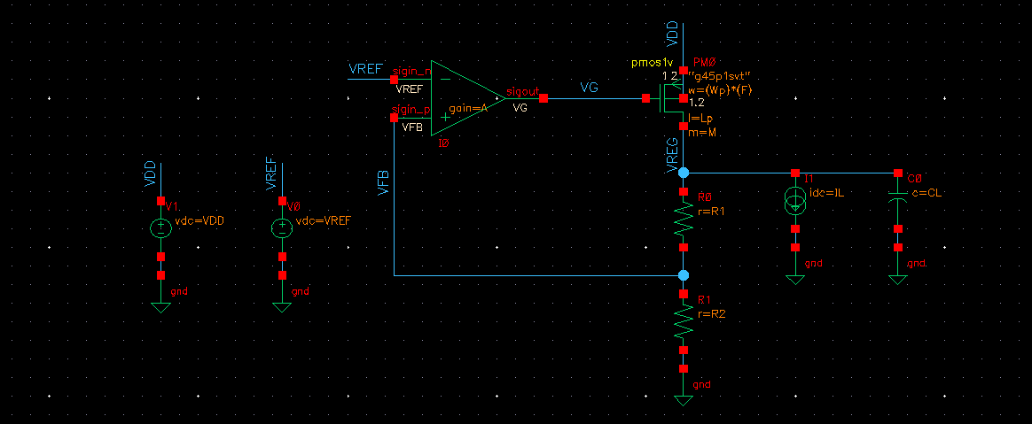
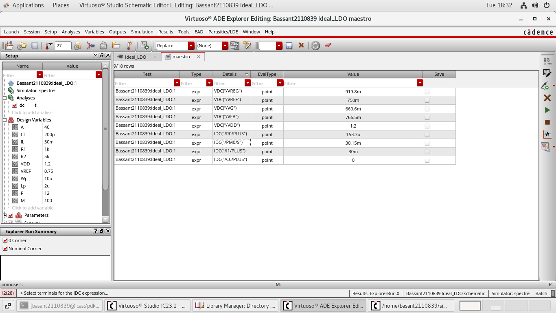
Ideal Low Drop out Regulator to Measure DC Parameter
PARAMETER | SPEC | ACHIEVED
VREG | 900m | 919.8m

Slide 35
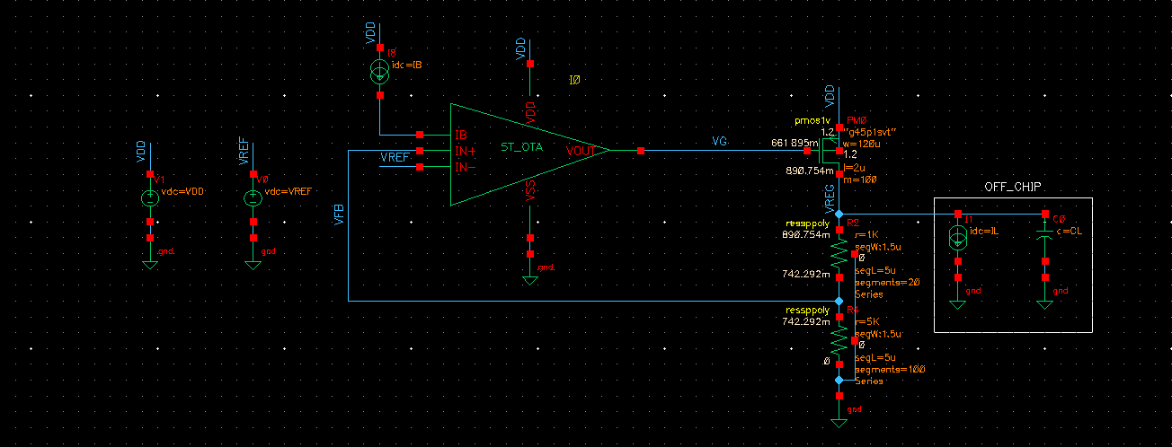
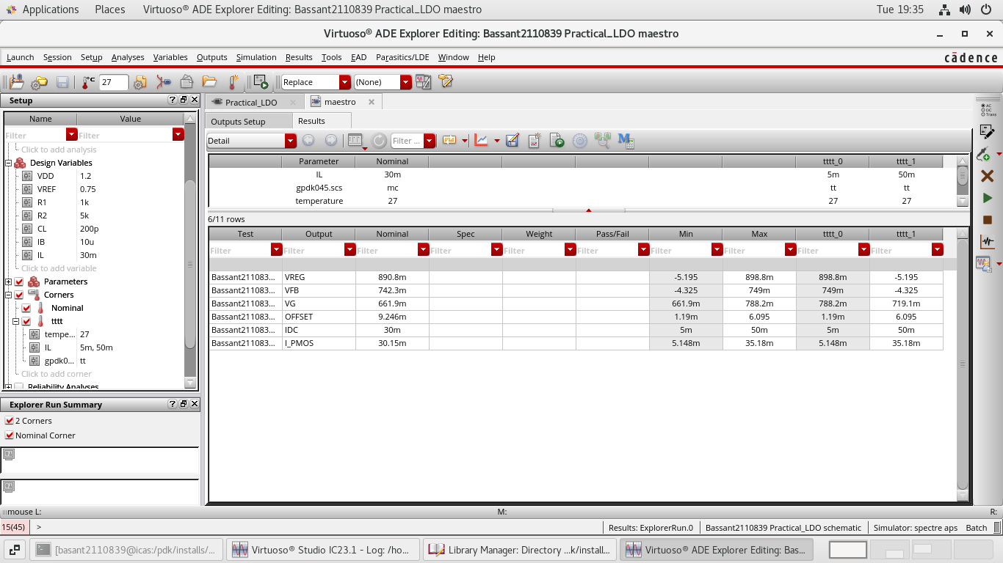
Practical Low Drop out Regulator to measure DC Parameter with corners
PARAMETER | SPEC | ACHIEVED
VREG | 900m | 919.8m

Slide 36
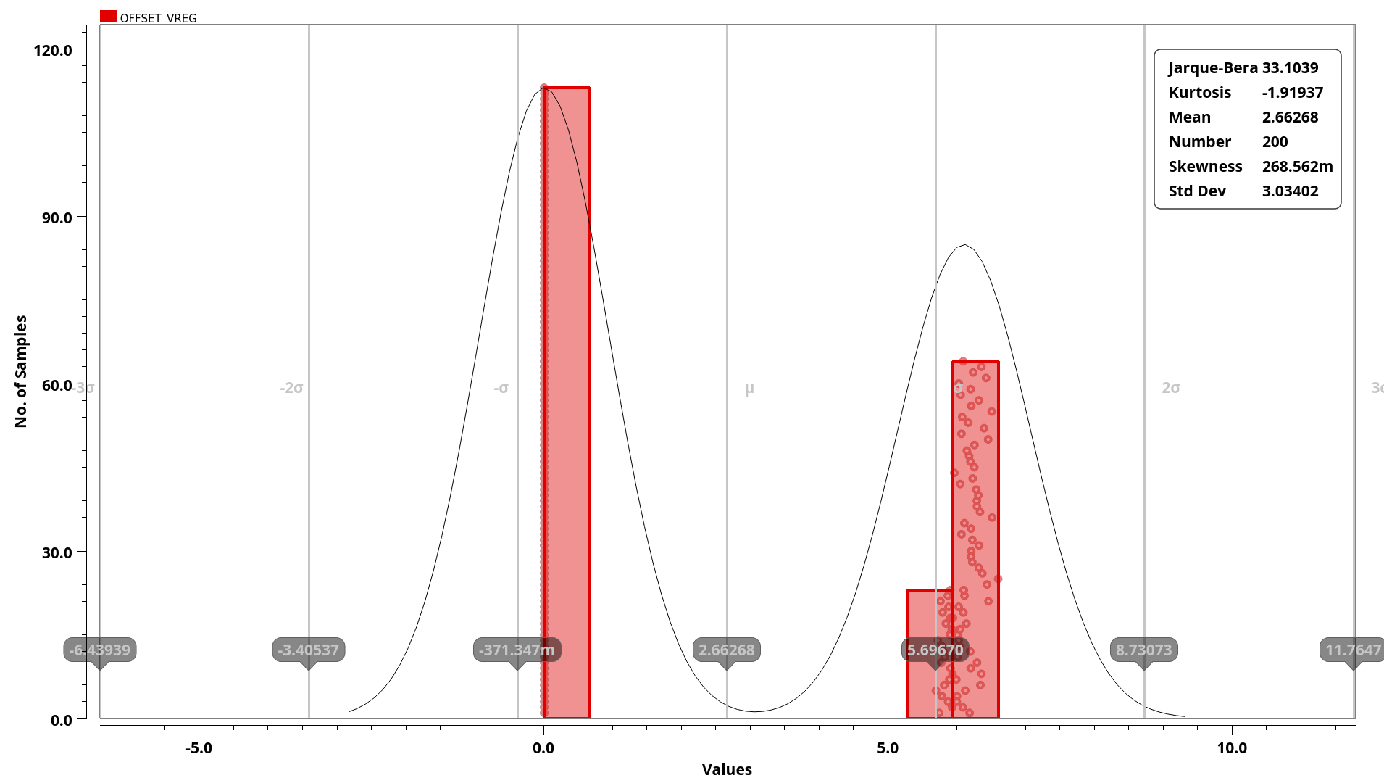
Monte Carlo simulation for offset when IL= 30mA

Slide 37
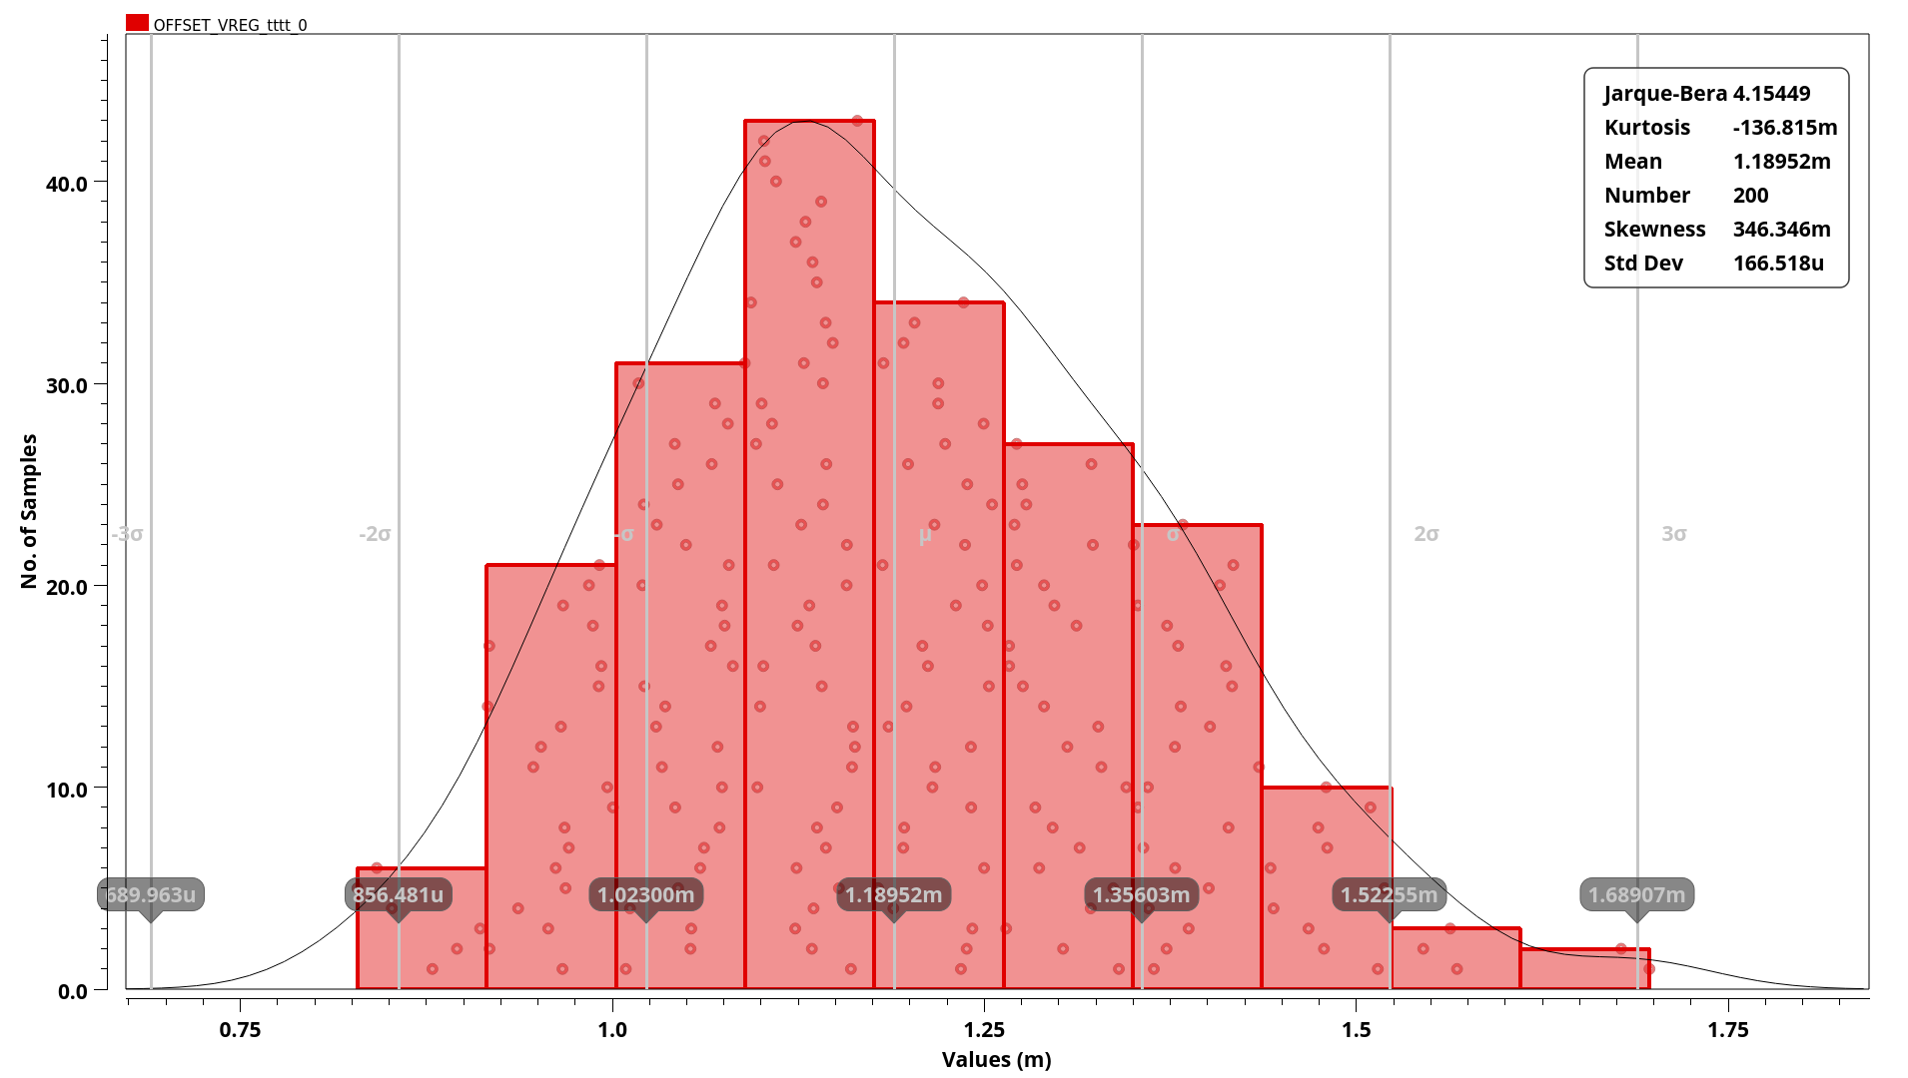
Monte Carlo simulation for offset when IL= 5mA

Slide 38
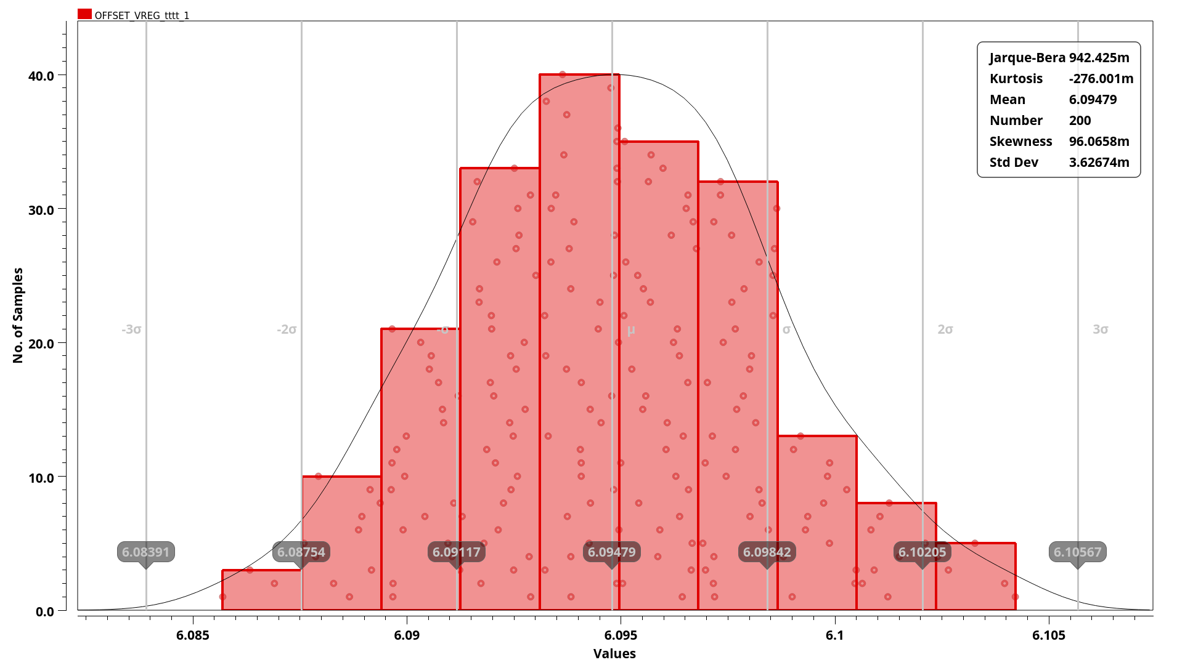
Monte Carlo simulation for offset when IL= 50mA

Slide 39
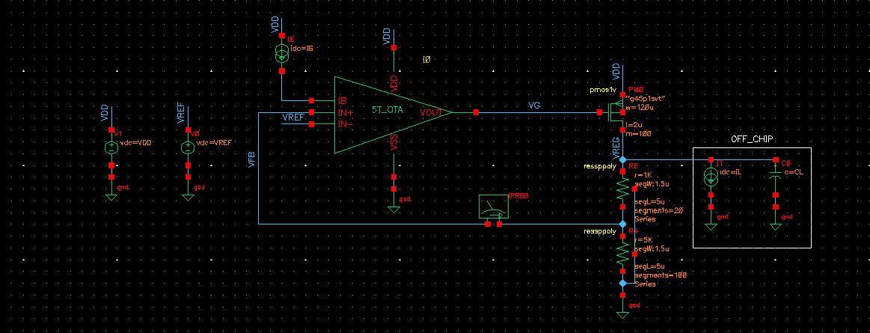
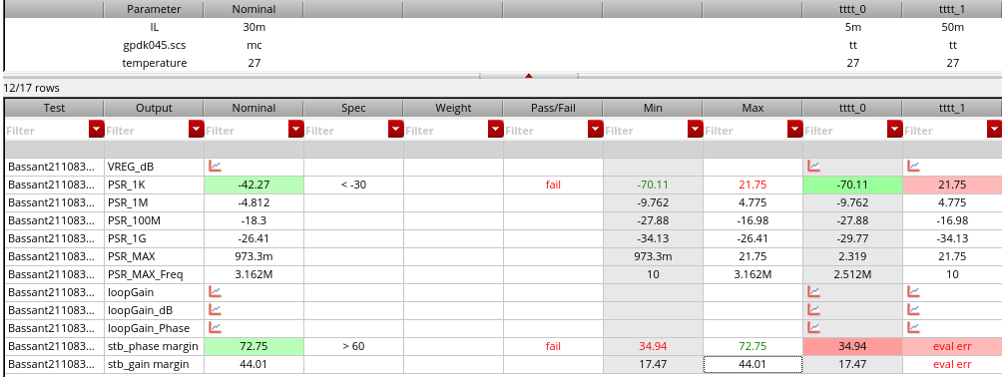
Practical LDO to measure AC & STB Parameter with corners
PARAMETER | SPEC | ACHIEVED
PSR | <-30dB | -40dB
PHASE MARGIN | >60 | 72

Slide 40
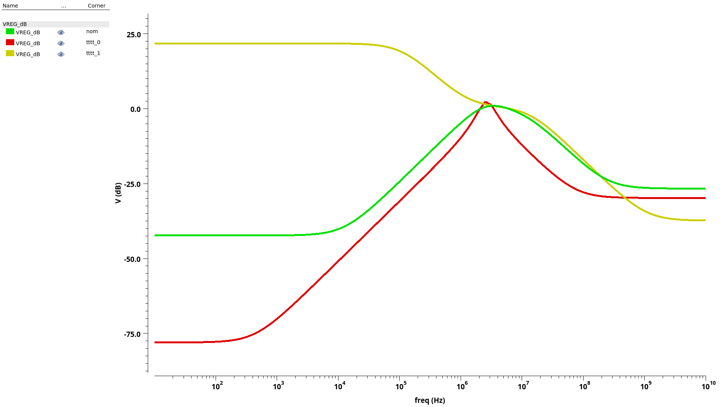
PSR Parameter with corners

Slide 41
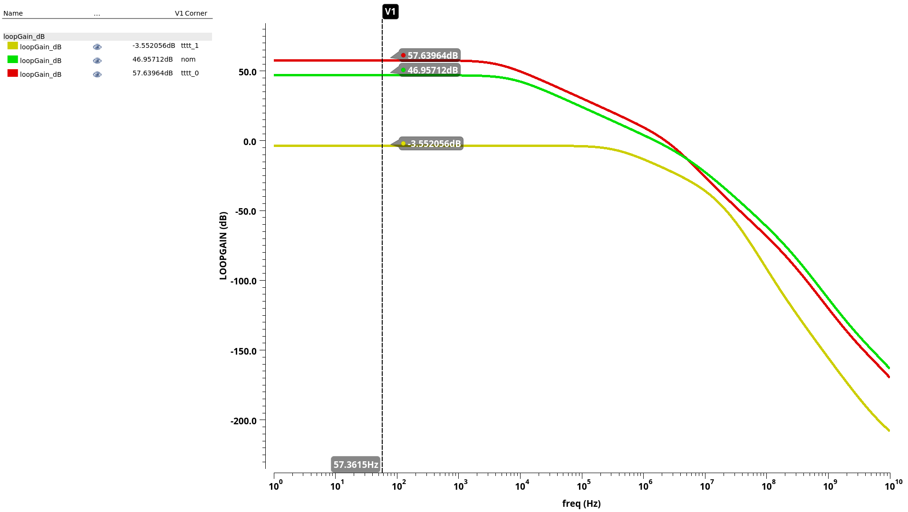
Measuring gain with corners
PARAMETER | SPEC | ACHIEVED
GAIN | >40dB | 46dB

Slide 42
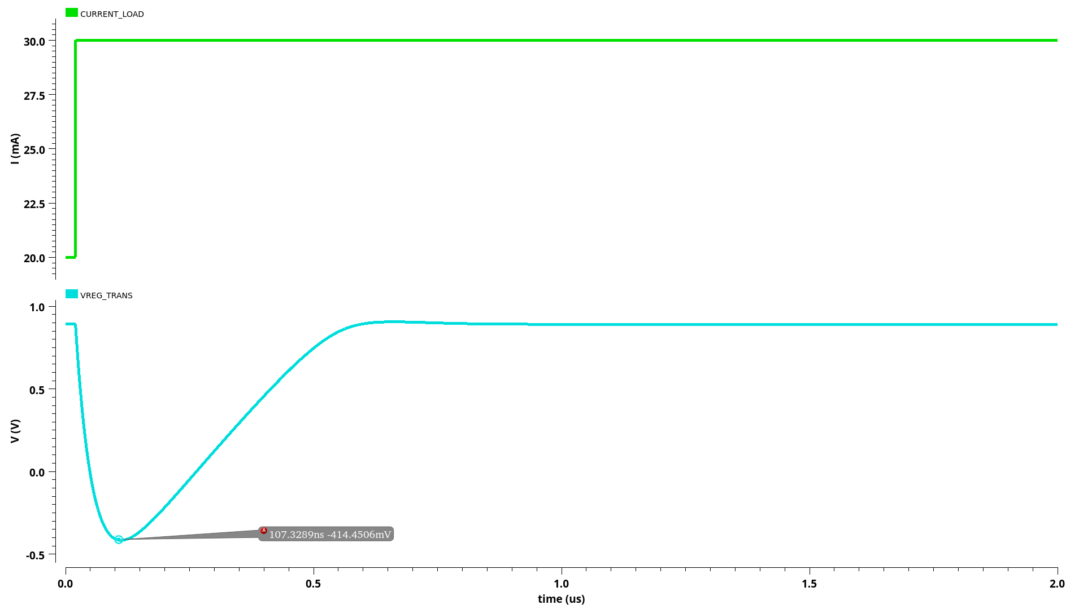
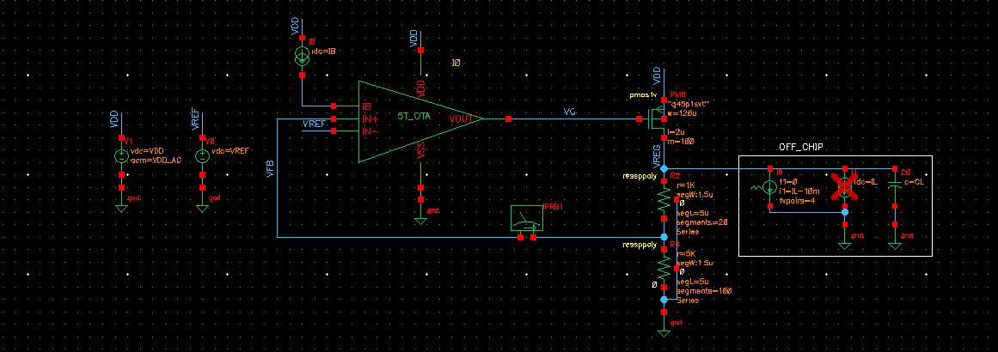
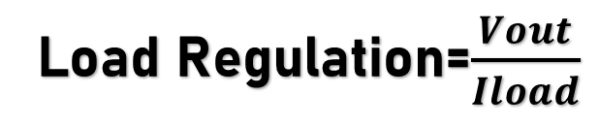
Transient analysis to see the effect of load regulation
Load Regulation=$\frac{Vout}{Iload}$

